Slide 1
Vet Science Tools Part II

Slide 2
Forceps – Rat tooth thumb

Slide 3
Mouth gag speculum (small)

Slide 4
Mouth gag speculum (large)

Slide 5
Gravity feeder/ J tube

Slide 6
Head Gate

Slide 7
Hog snare

Slide 8
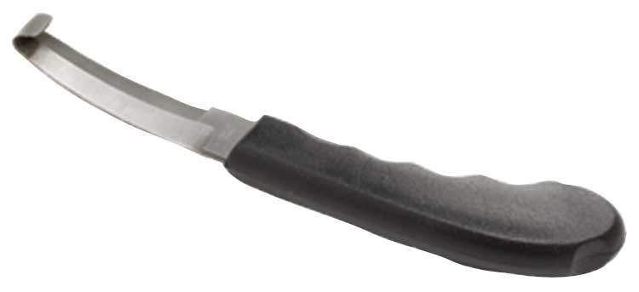
Hoof Knife

Slide 9
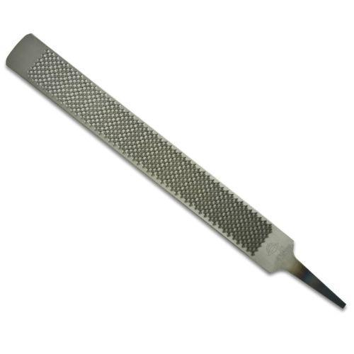
Hoof Rasp

Slide 10
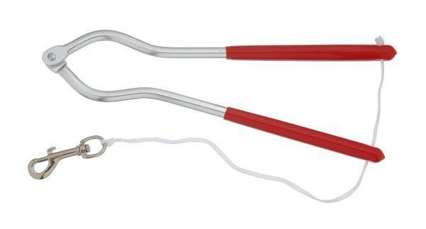
Humane Twitch

Slide 11
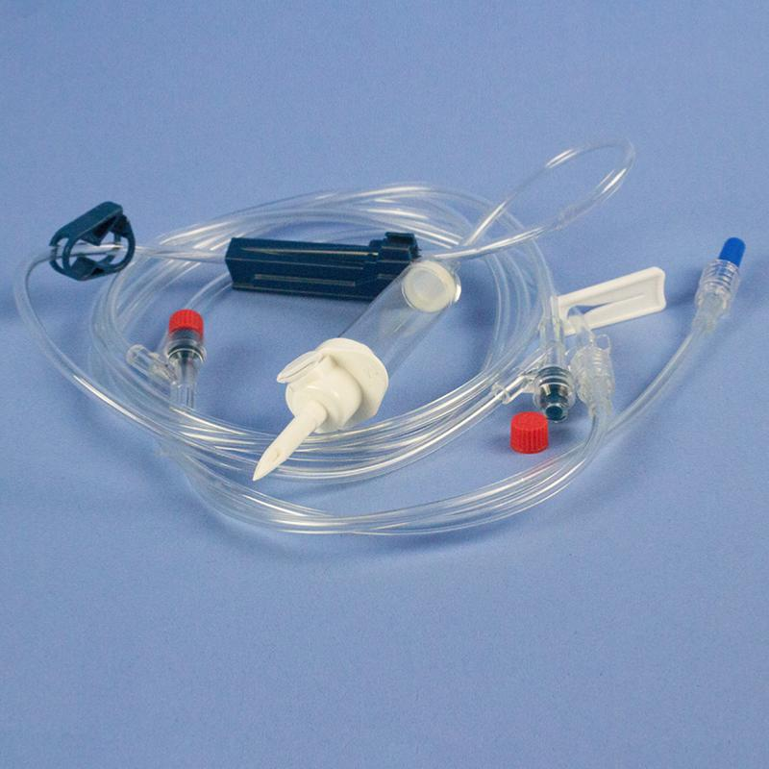
IV administration

Slide 12
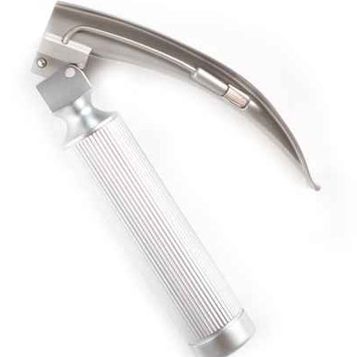
Laryngoscopes

Slide 13
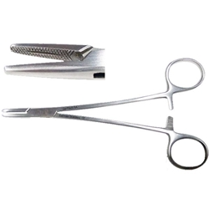
Needle holder- Mayo-Hegar

Slide 14
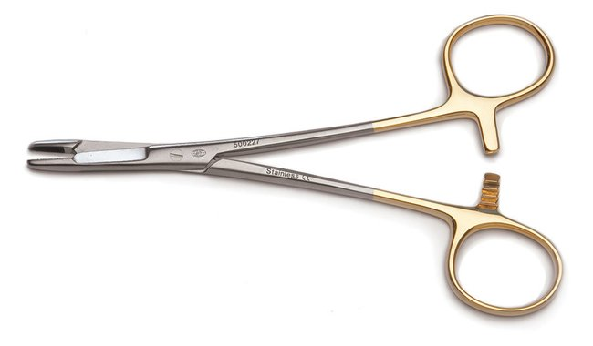
Needle holder – Olsen-Hegar

Slide 15
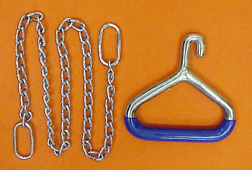
Obstetrical chain and handle

Slide 16
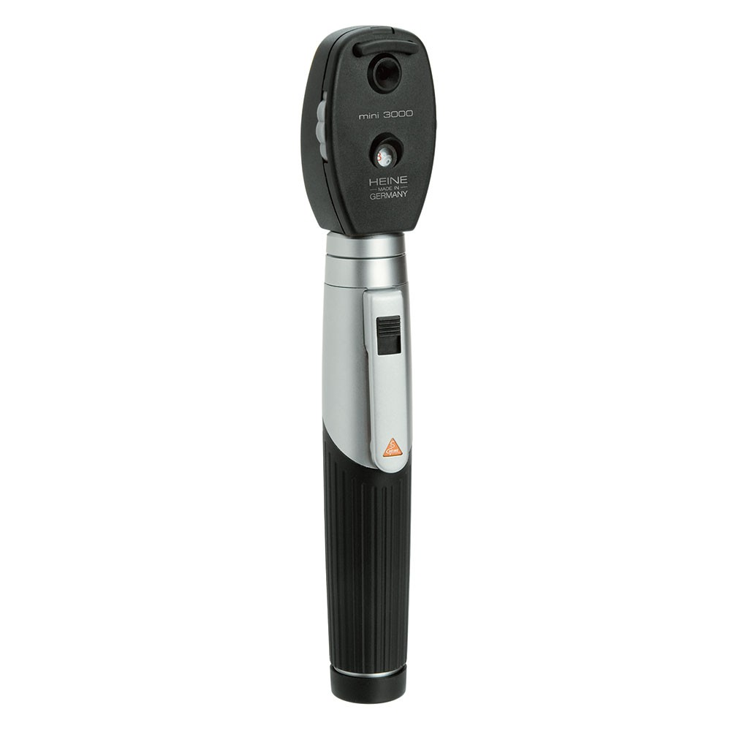
Opthalmoscope

Slide 17
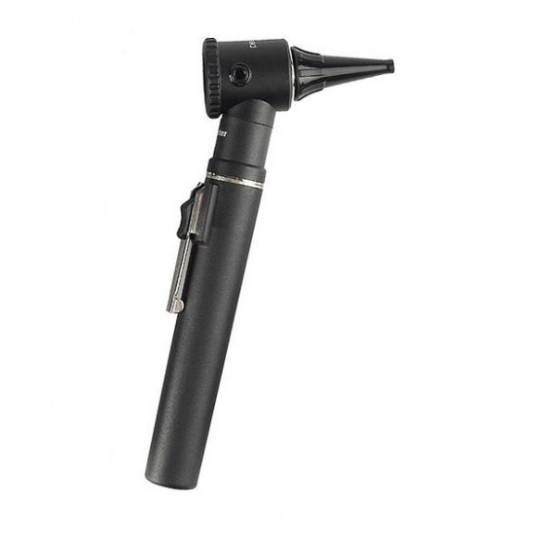
Otoscope

Slide 18
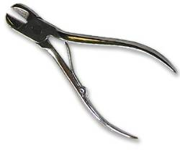
Pig tooth nippers

Slide 19
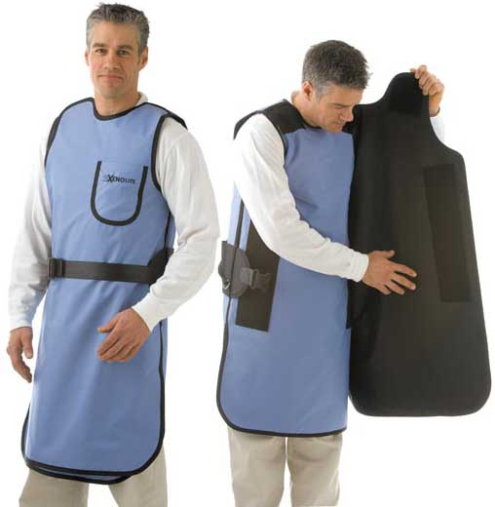
Radiology Personal Protective Equipment

Slide 20
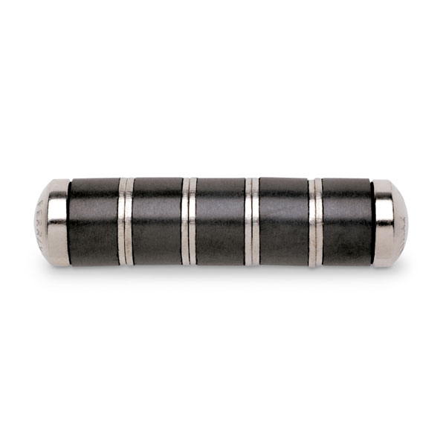
Rumen Magnet

Slide 21
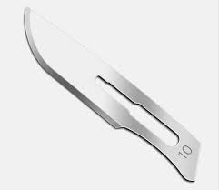
Scalpel Blade

Slide 22
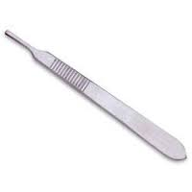
Scalpel Handle

Slide 23
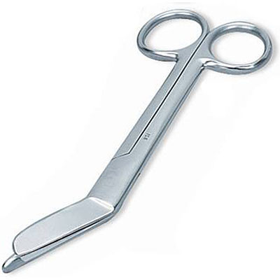
Scissors- Bandage

Slide 24
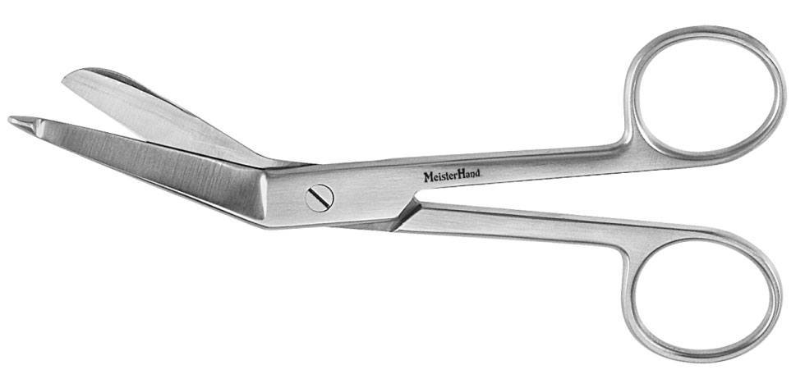
Scissors- Lister bandage

Slide 25
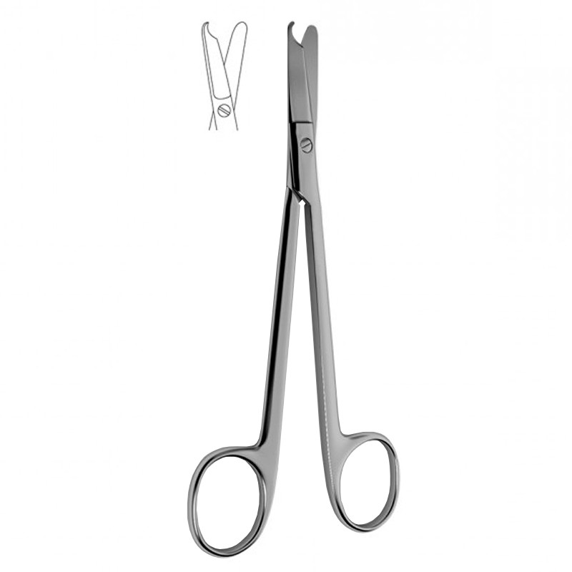
Scissors- Littauer suture removal

Slide 26
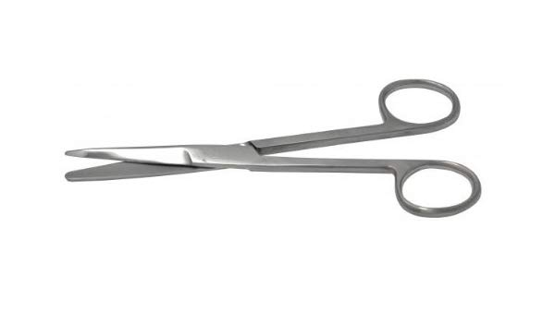
Scissors- Mayo dissecting

Slide 27
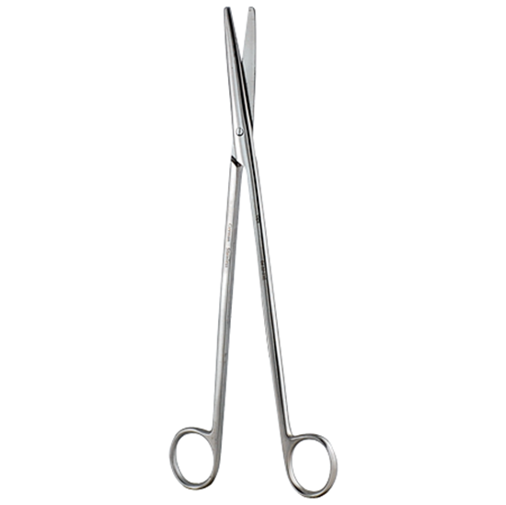
Scissors- Metzenbaum dissecting

Slide 28
Basket Muzzle

Slide 29
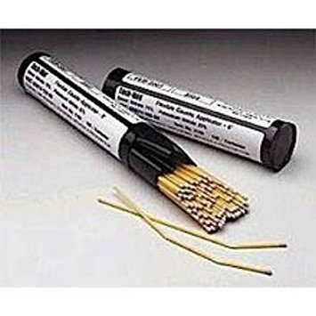
Silver nitrate sticks

Slide 30
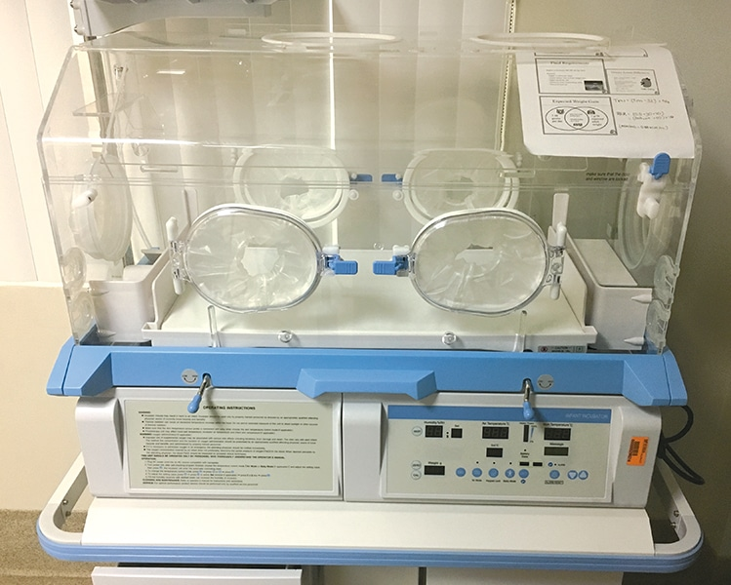
Small animal oxygen cage

Slide 31
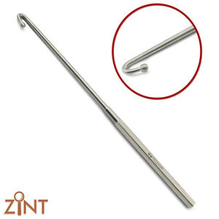
Snook ovariohysterectomy hook

Slide 32
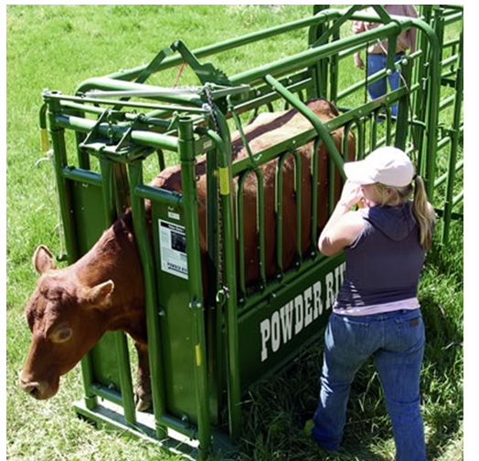
Squeeze chute

Slide 33
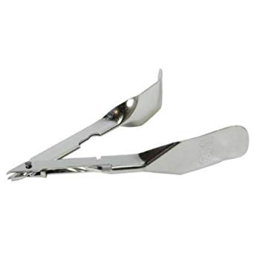
Staple remover

Slide 34
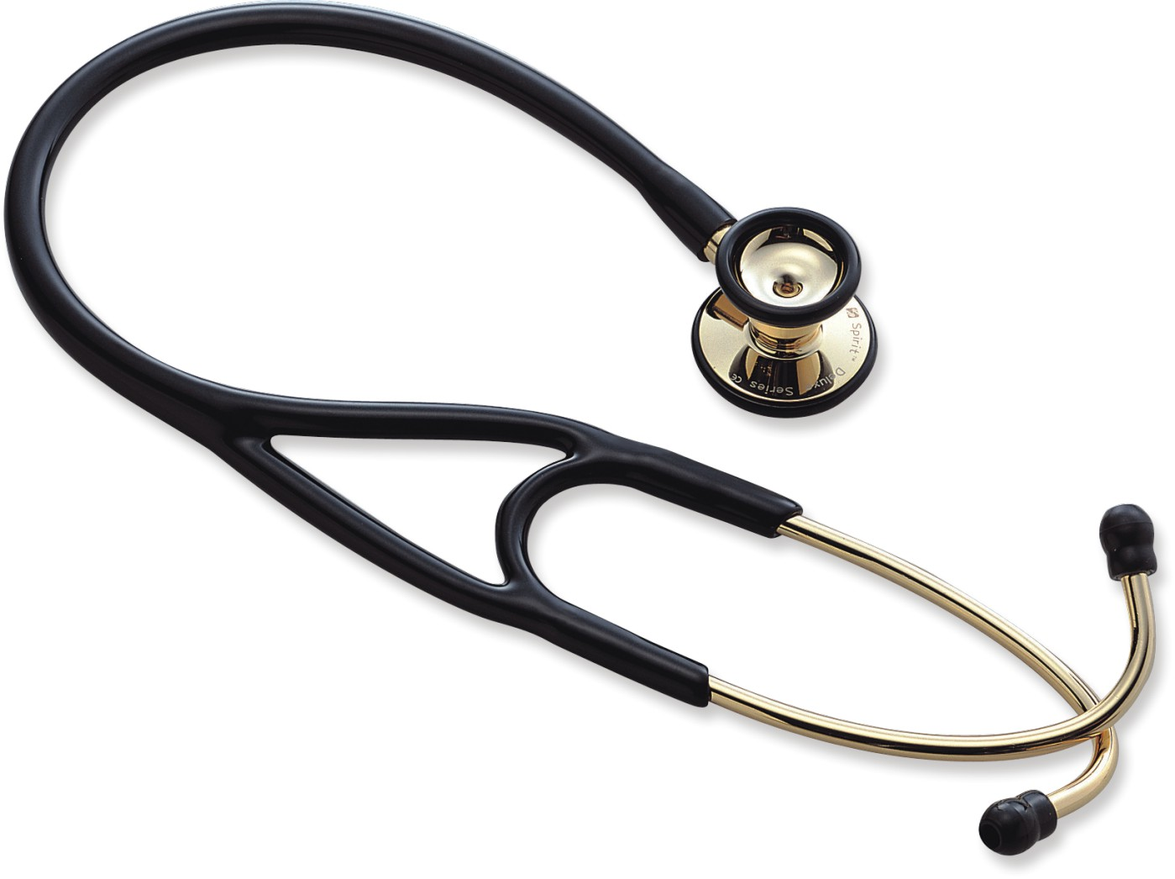
Stethoscope

Slide 35
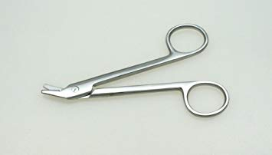
Suture wire cutting scissors

Slide 36
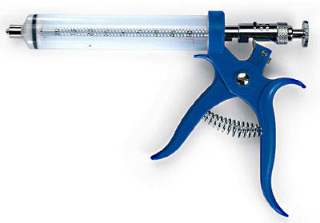
Syringe- automatic, multi-dose

Slide 37
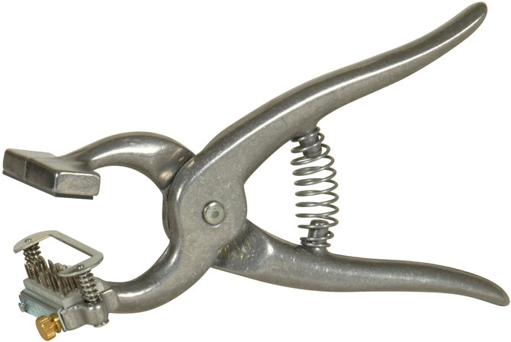
Tattooing instruments- small and large

Slide 38
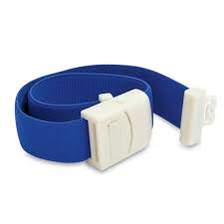
Tourniquet

Slide 39
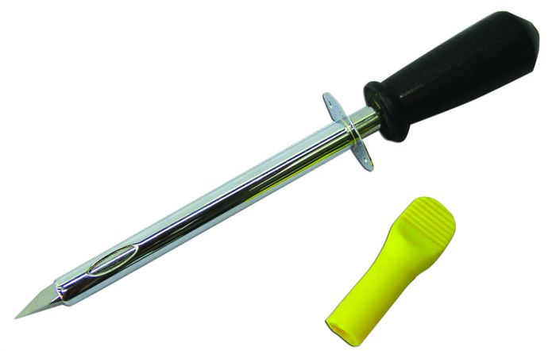
Trocar & cannula

Slide 40
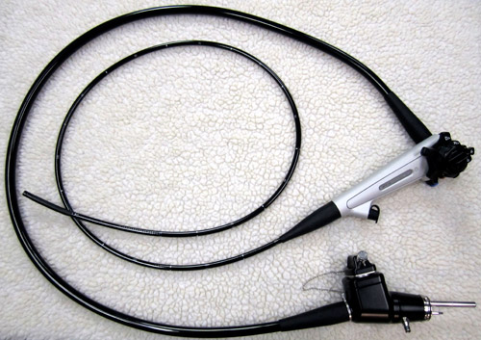
Endoscope

Slide 41
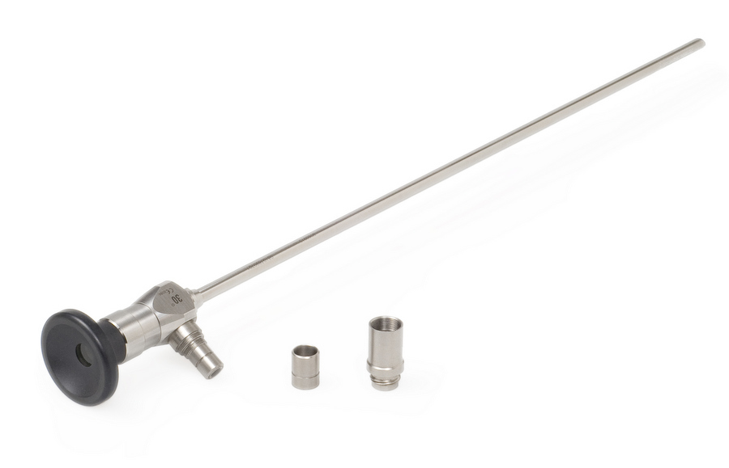
Laprascope

Slide 42
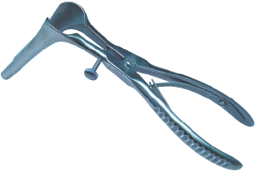
Speculum Vaginal

Slide 43
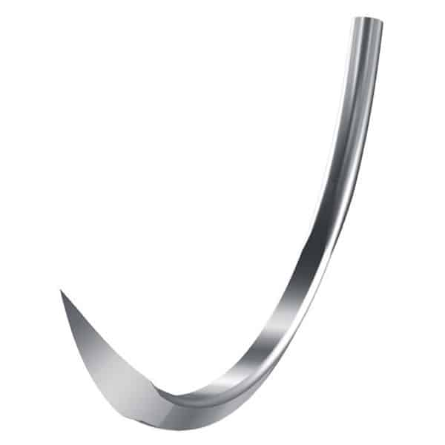
Suture Needle - Cutting

Slide 44
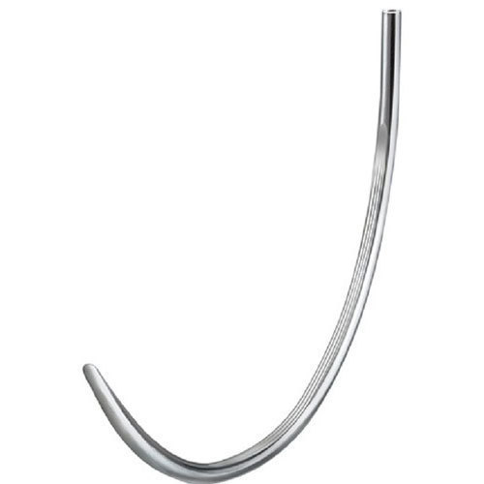
Suture Needle - Taper

Slide 45
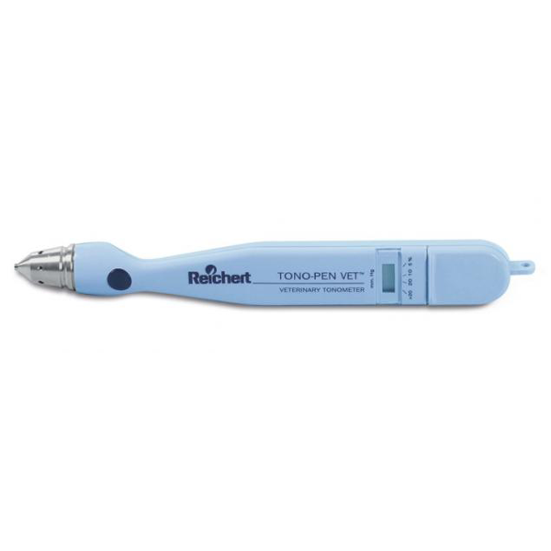
Tonometer

