Slide 1
Vet Science Equipment Part I (updated 11/8/19)

Slide 2
Anesthesic Machine

Slide 3
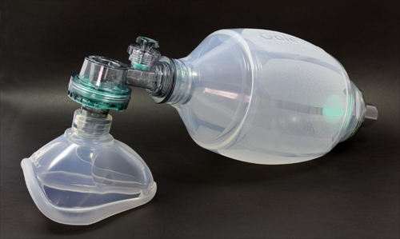
Ambubag

Slide 4
Autoclave

Slide 5
Autoclave Tape Indicator

Slide 6
Bakhaus towel clamps

Slide 7
Balling Gun

Slide 8
Band (castration or docking)

Slide 9
Bandaging Material- Elasticon

Slide 10
Bandaging material- roll gauze

Slide 11
Bandaging Material- vet wrap

Slide 12
Cat bag

Slide 13
Catch pole (dog snare)

Slide 14
Catheter - IV

Slide 15
Catheter – butterfly

Slide 16
Catheter – urine

Slide 17
Centrifuge

Slide 18
Chain twitch

Slide 19
Chemical Indicator Strips

Slide 20
Surgical drapes

Slide 21
Cold sterile tray

Slide 22
Dehorner- Barnes

Slide 23
Dehorner- electric

Slide 24
Dehorner- scoop or tube

Slide 25
Dental Floats

Slide 26
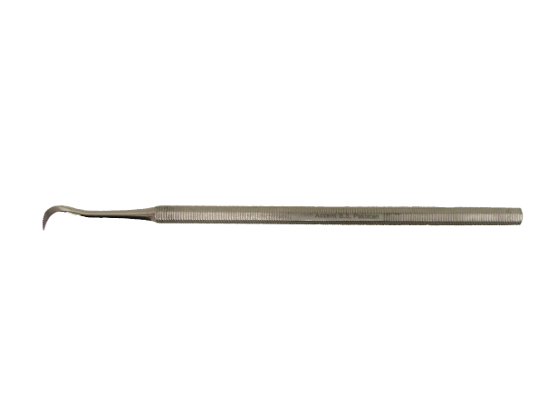
Dental Scaler
v

Slide 27
Drench gun

Slide 28
Ear notcher

Slide 29
Elastrator

Slide 30
Elizabethan collar

Slide 31
Emasculators

Slide 32
Endotracheal tubes

Slide 33
Fecal loop

Slide 34
Fecalizers

Slide 35
Feeding tube for small animals

Slide 36
Fetal extractors

Slide 37
Forceps - Alligator

Slide 38
Forceps – Allis tissue

Slide 39
Forceps – Babcock tissue

Slide 40
Forceps – Brown-Adson thumb

Slide 41
Forceps - Crile

Slide 42
Forceps – Halstead mesquito hemostatic

Slide 43
Forceps - Kelly

