Slide 1
Cats

Slide 2
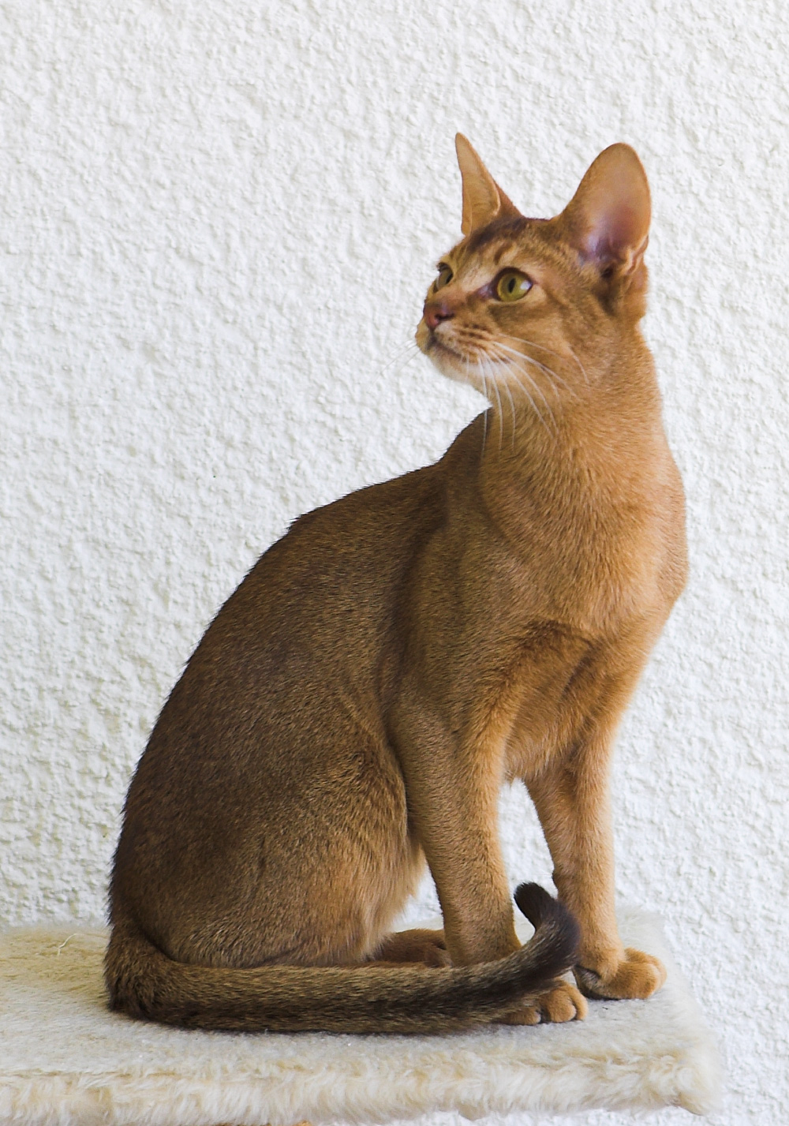
Abyssinian

Slide 3
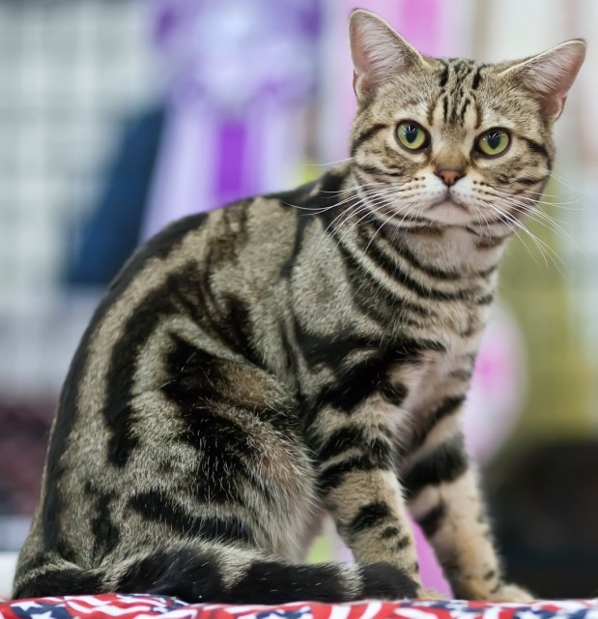
American Shorthair

Slide 4
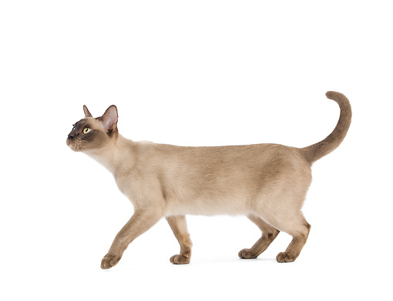
Burmese

Slide 5
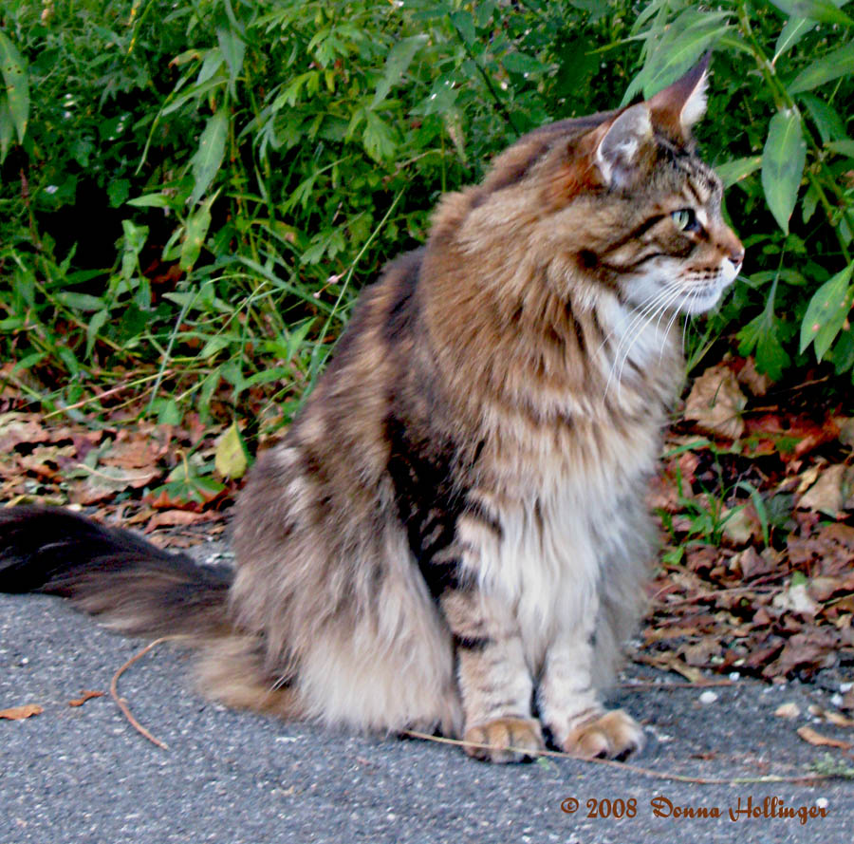
Maine Coon

Slide 6
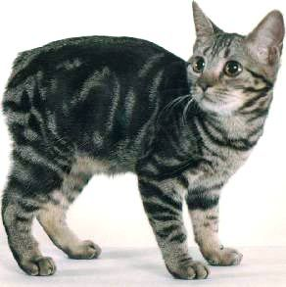
Manx

Slide 7
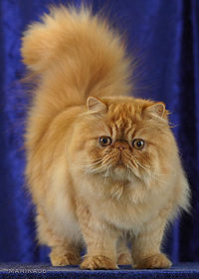
Persian

Slide 8
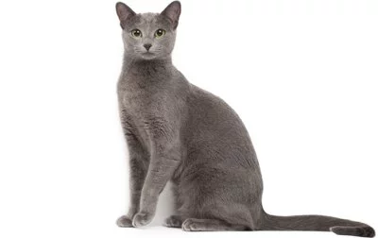
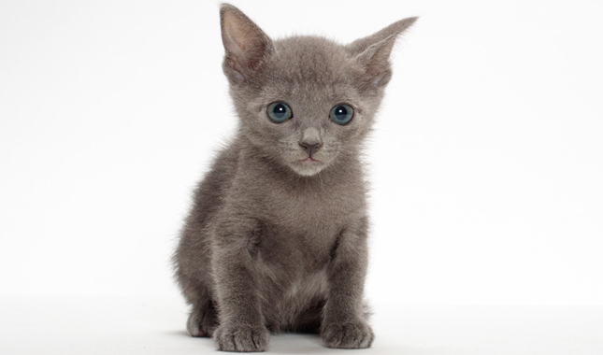
Russian Blue

Slide 9
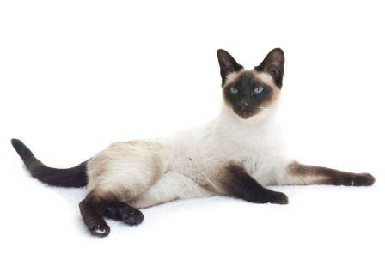
Siamese

Slide 10
Rabbits

Slide 11
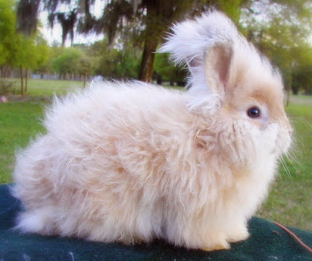
Angora

Slide 12
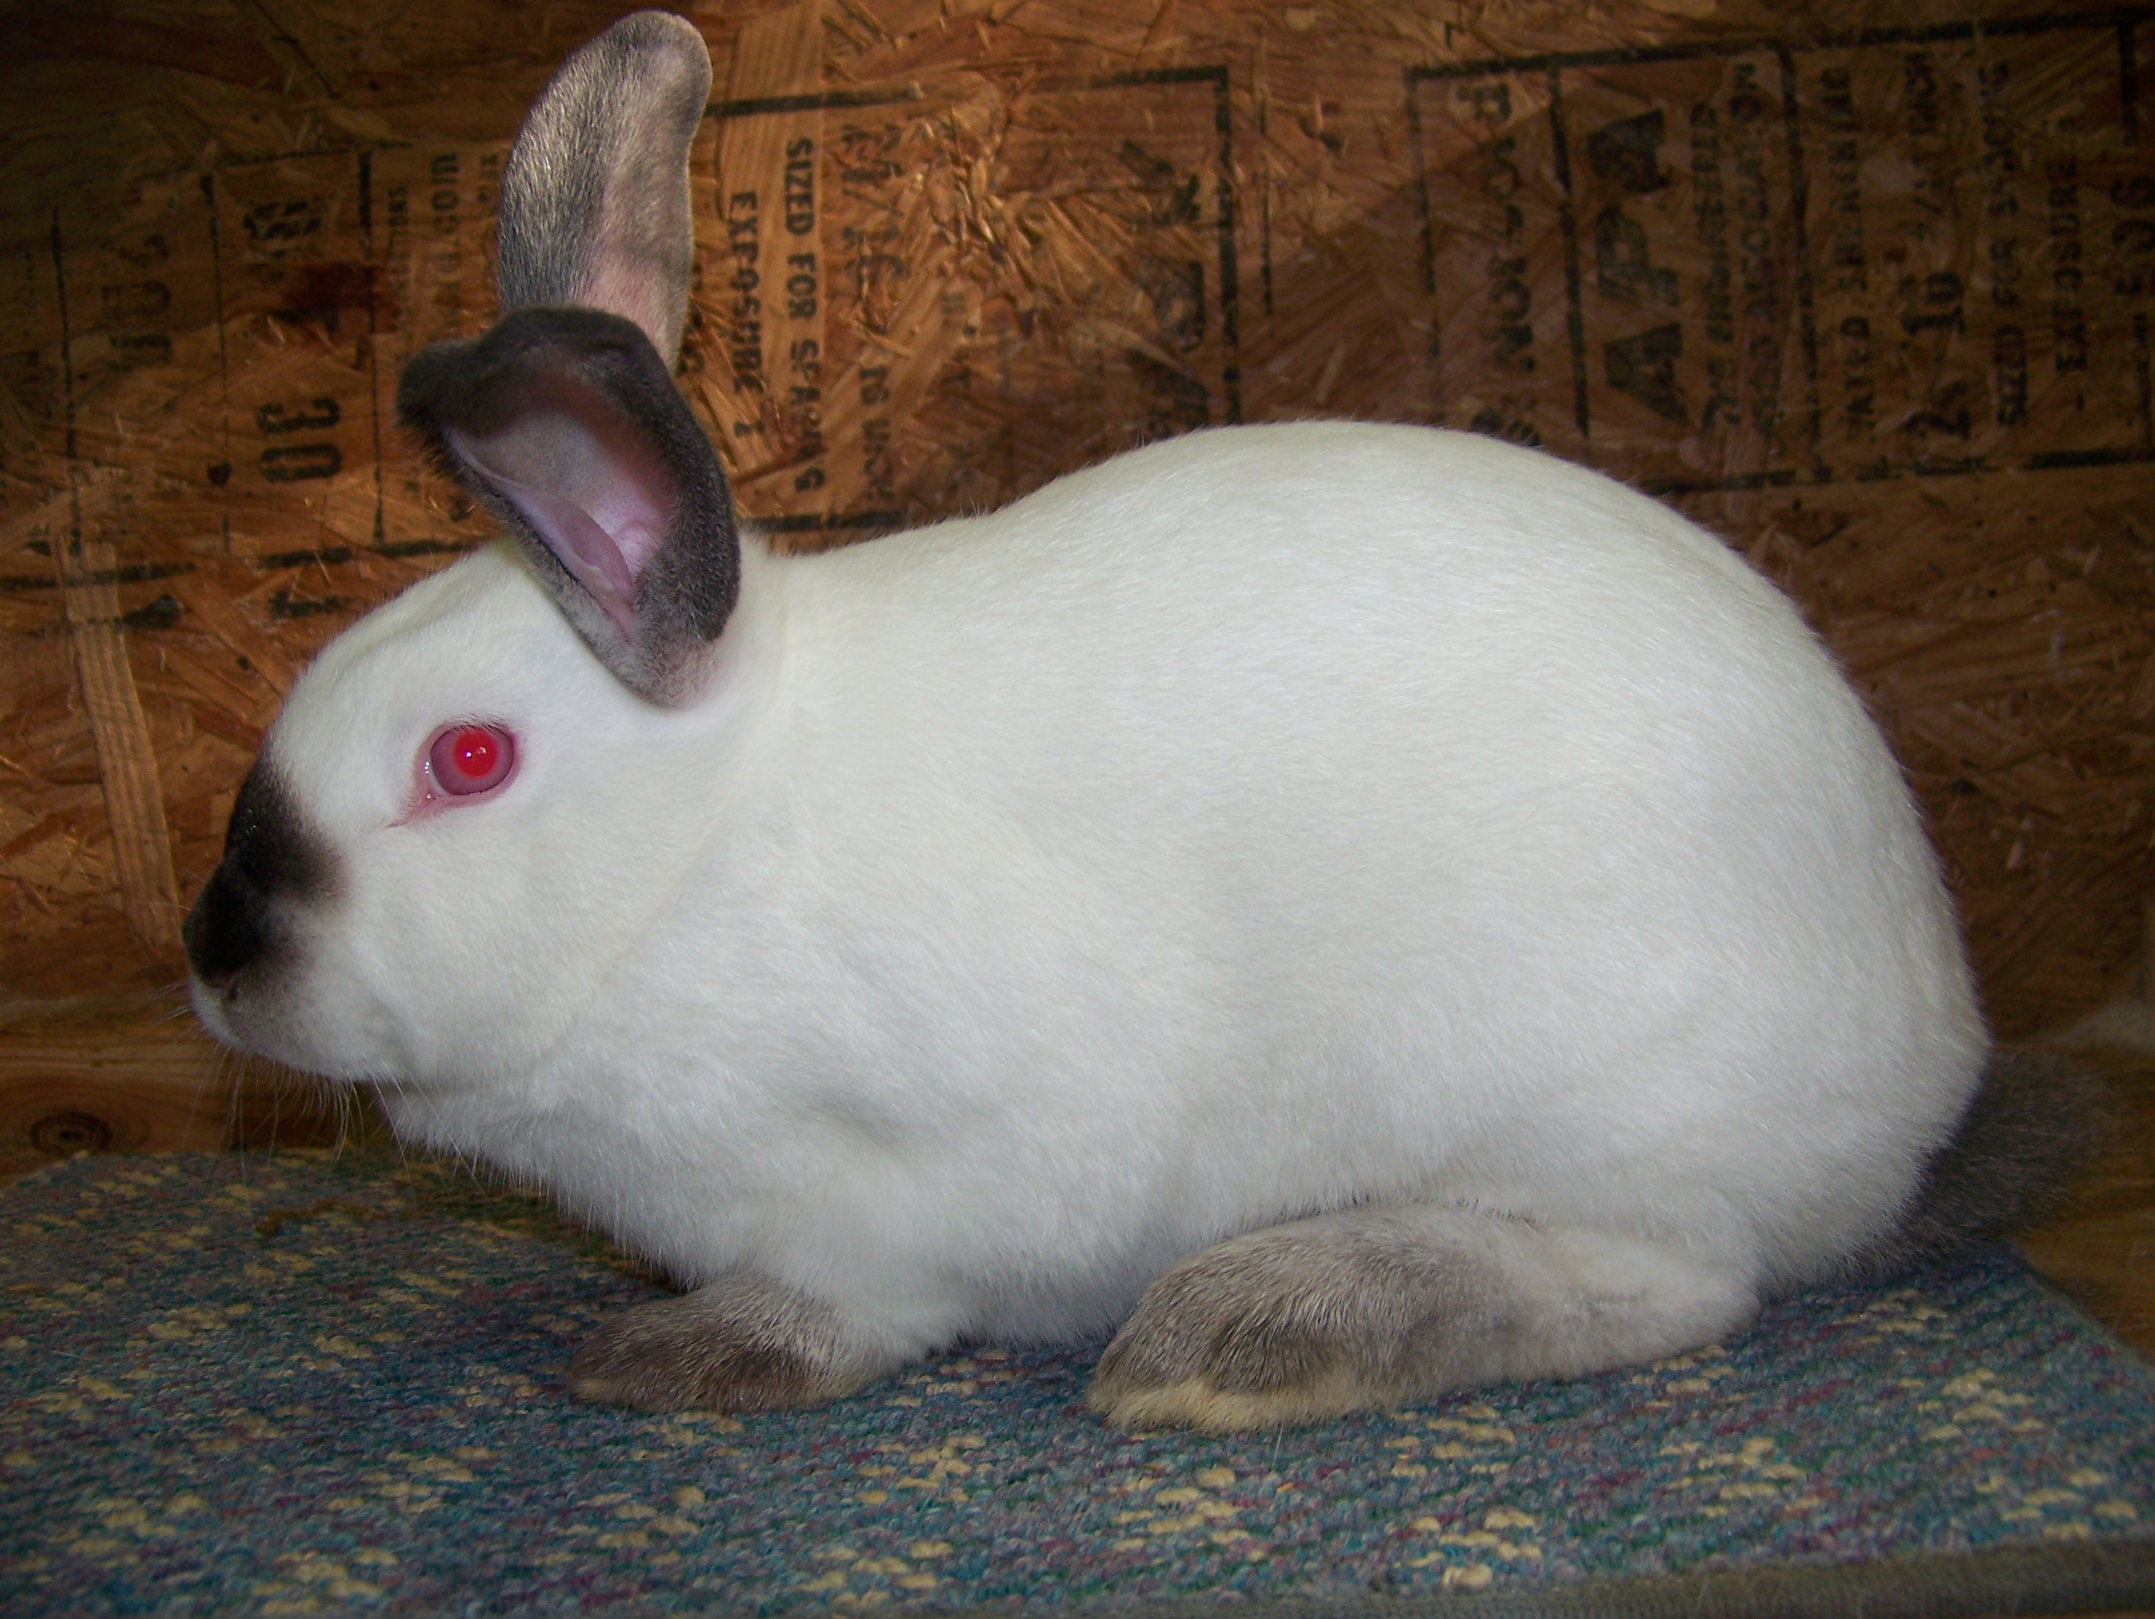
Californian

Slide 13
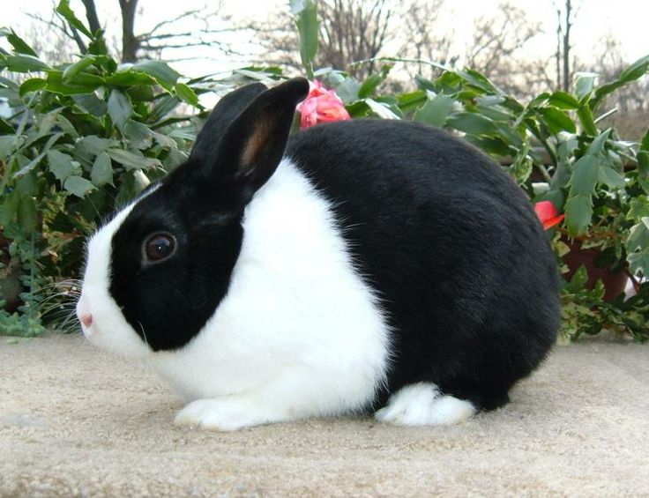
Dutch

Slide 14
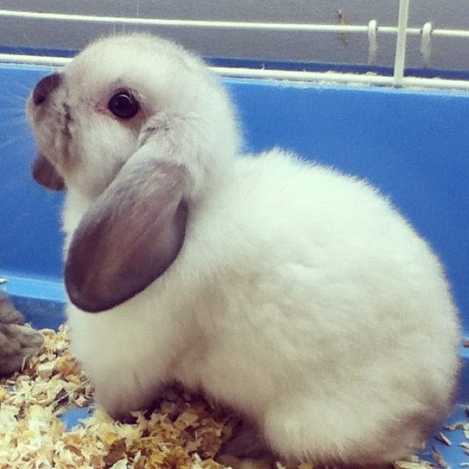
Holland Lop

Slide 15
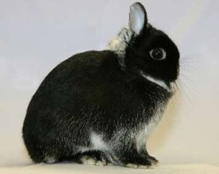
Netherland Dwarf

Slide 16
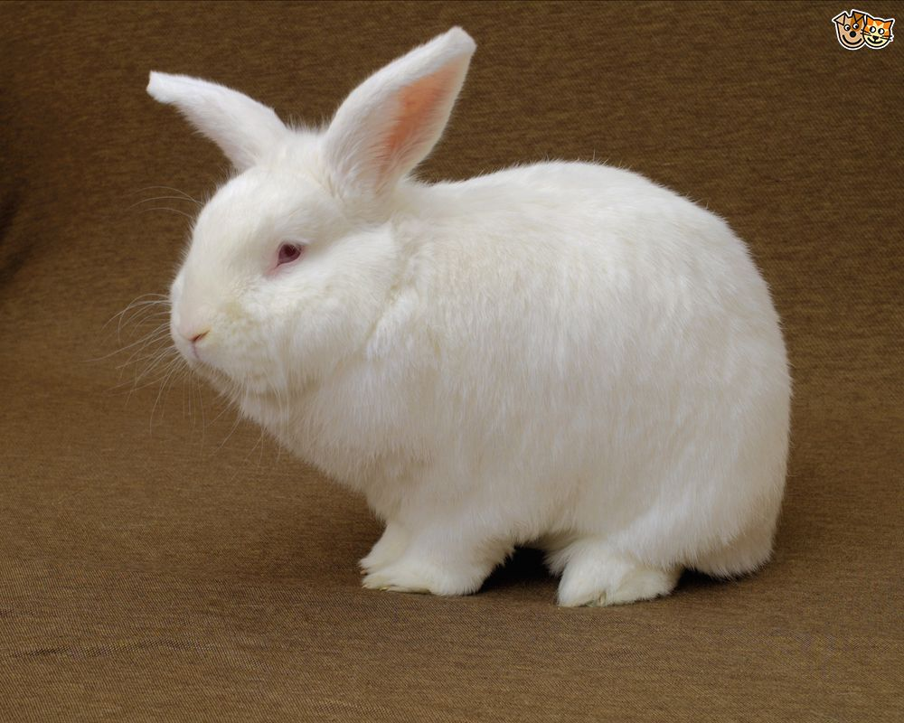
New Zealand

Slide 17
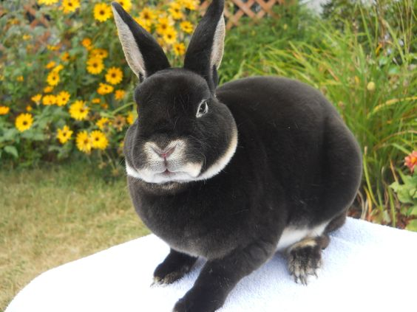
Mini-Rex

Slide 18
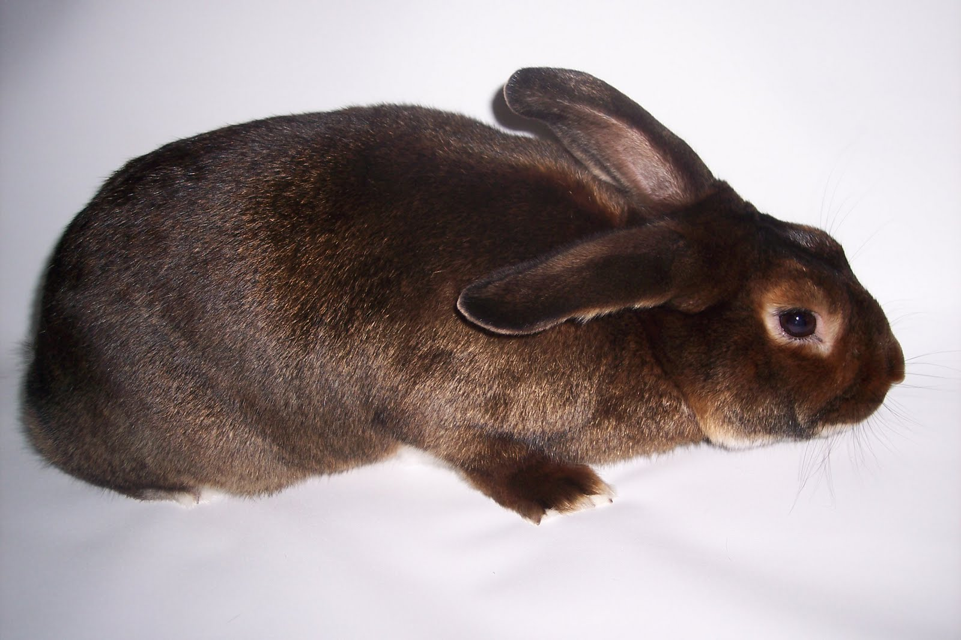
Satin

Slide 19
Birds

Slide 20
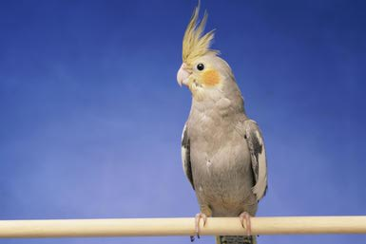
Cockatiel

Slide 21
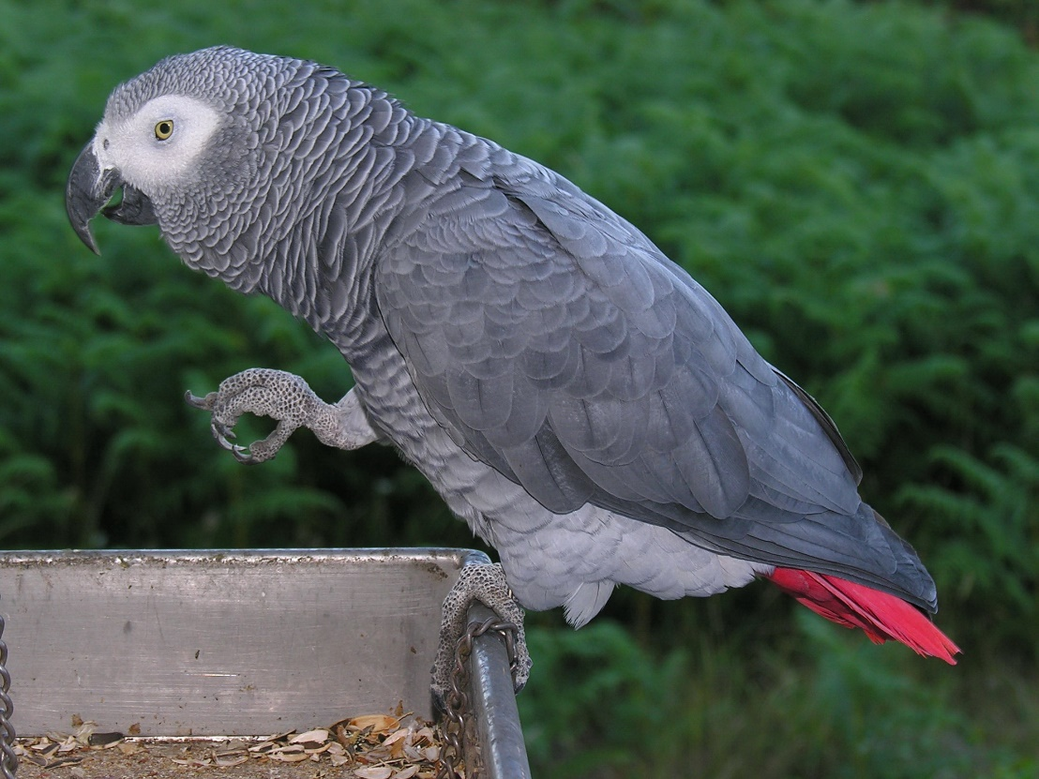
African Grey Parrot

Slide 22
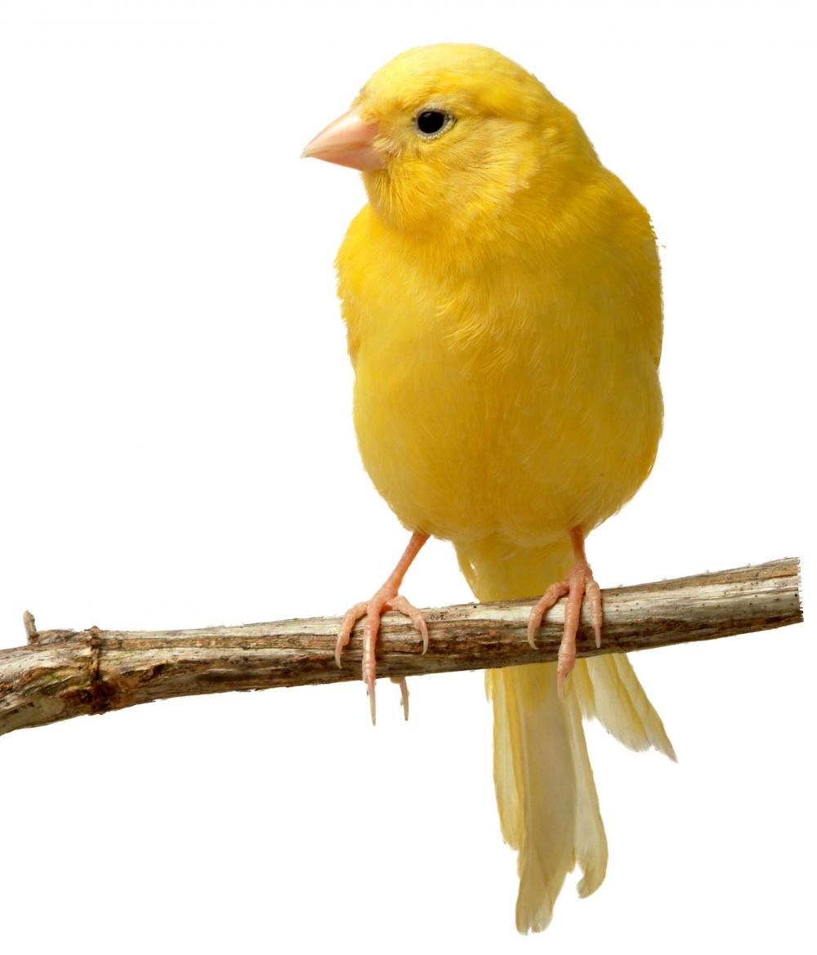
Canary

Slide 23
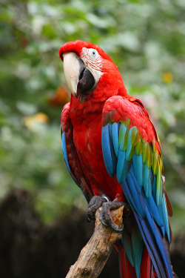
Macaw

Slide 24
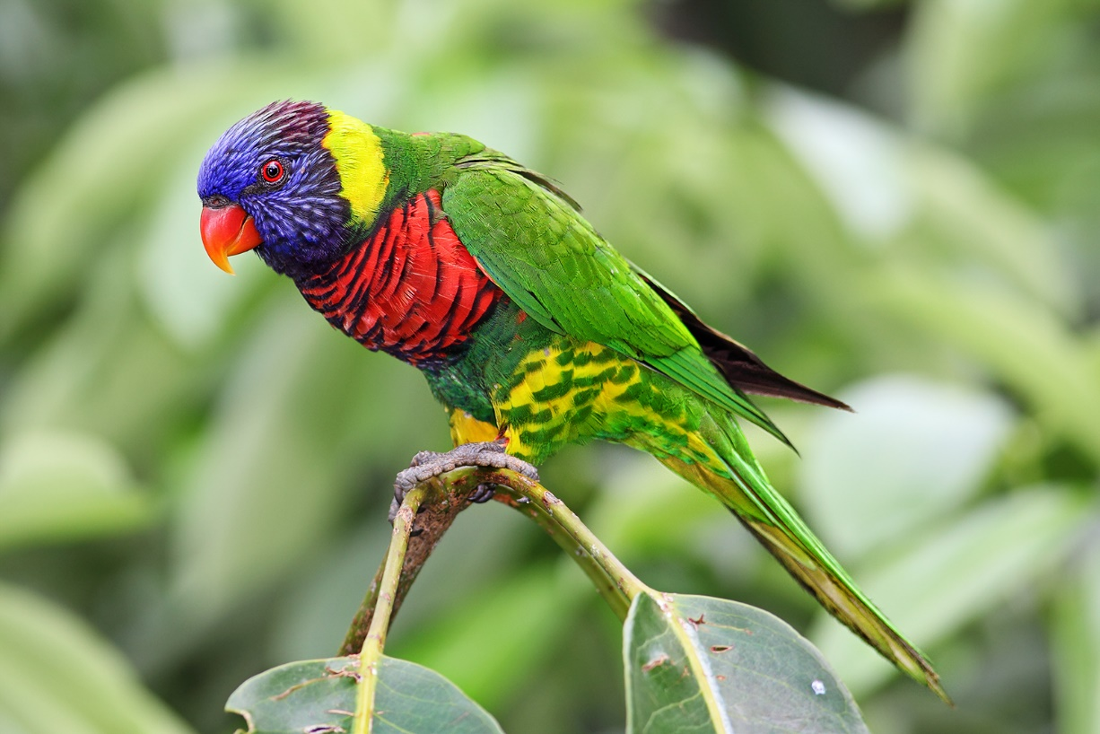
Rainbow Lorikeet

Slide 25
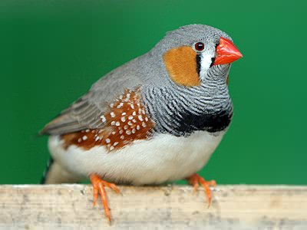
Zebra Finch

Slide 26
Small Mammals

Slide 27
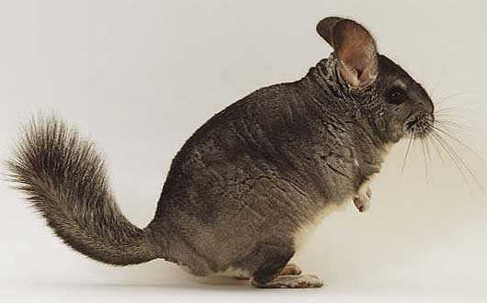
Chinchilla

Slide 28
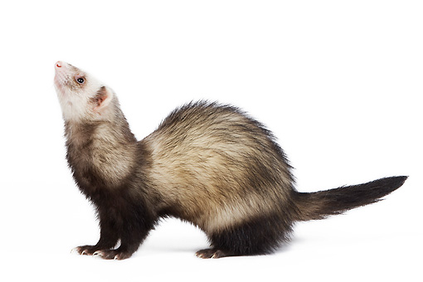
Ferret

Slide 29
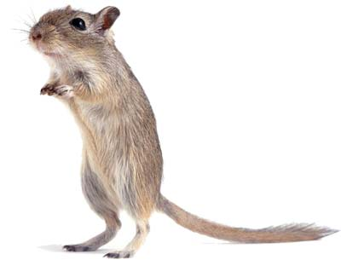
Gerbils

Slide 30
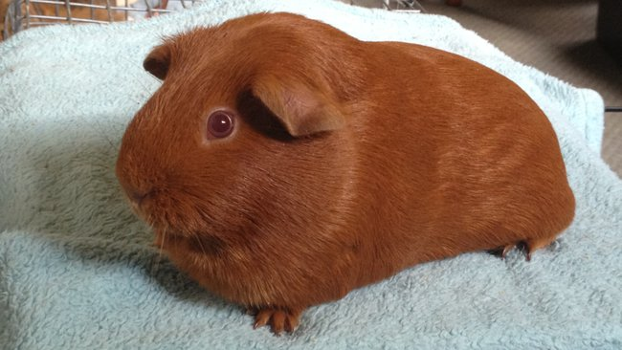
Guinea Pig

Slide 31
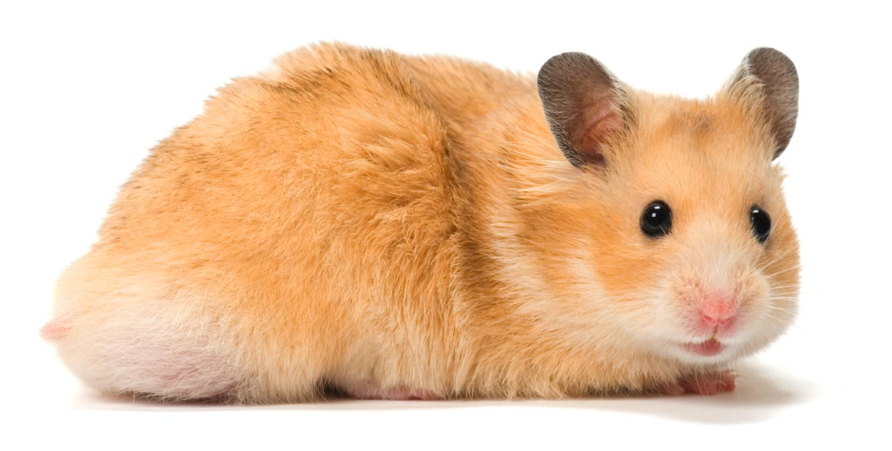
Hamster

Slide 32
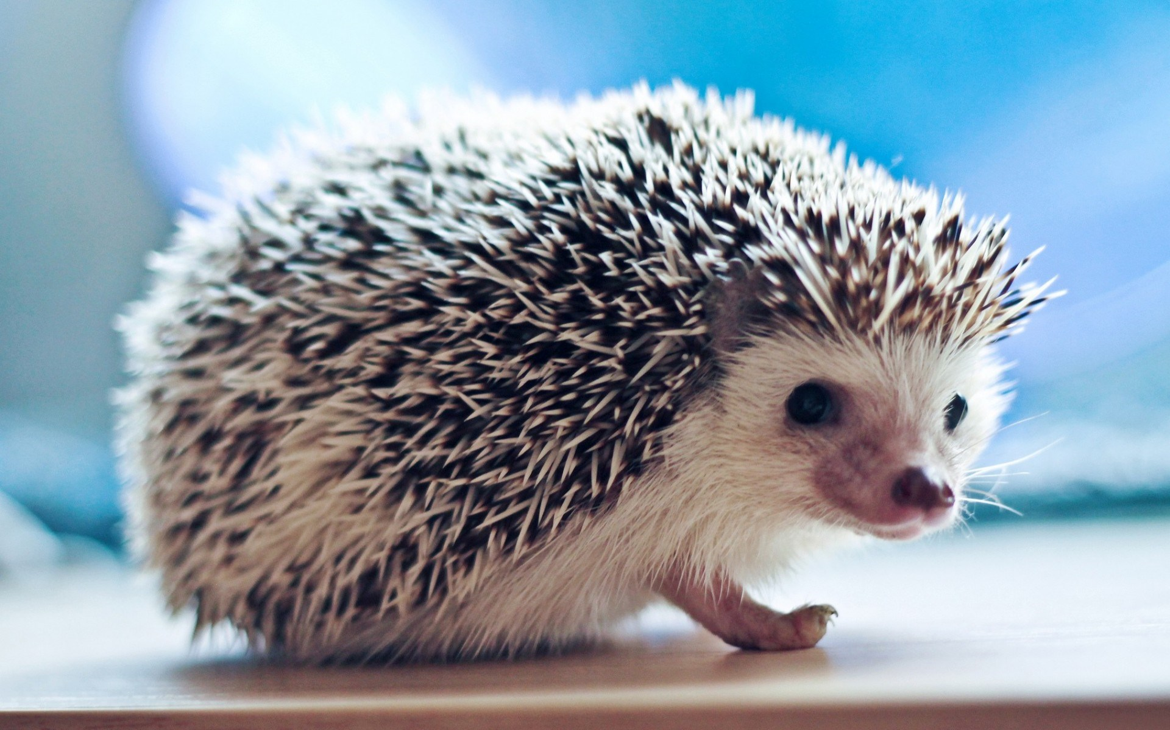
Hedgehog

Slide 33
Reptiles

Slide 34
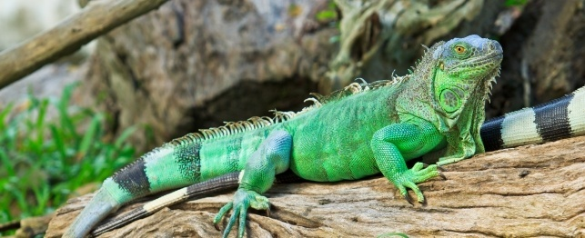
Iguana

Slide 35
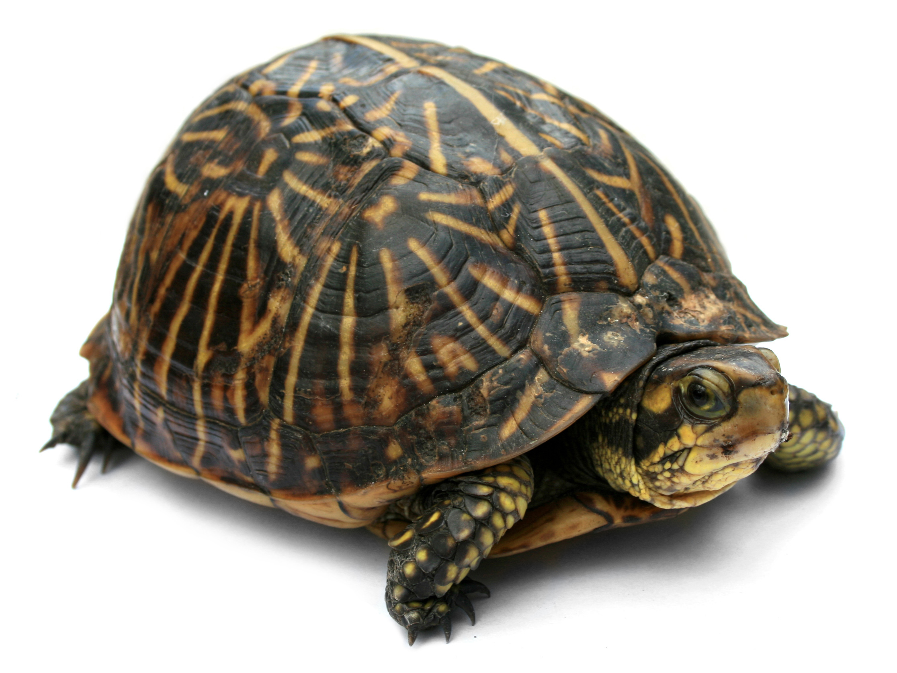
Turtle

Slide 36
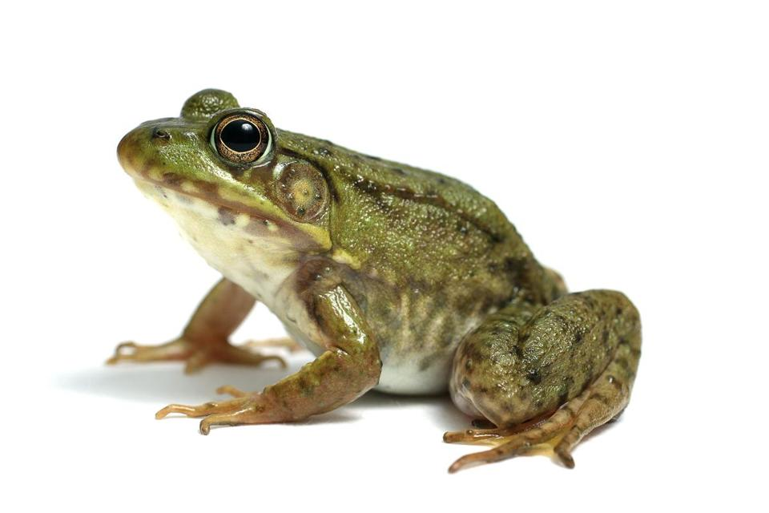
Frog

Slide 37
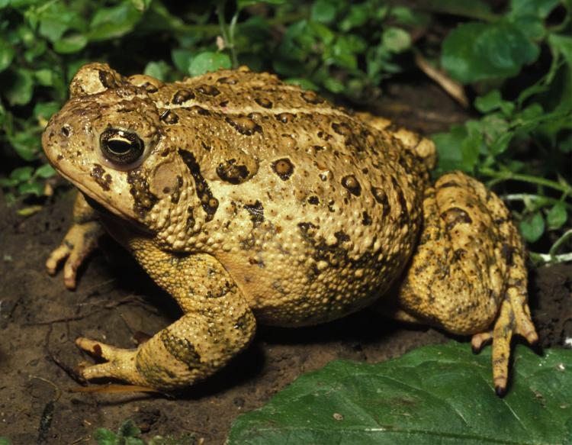
Toad

Slide 38
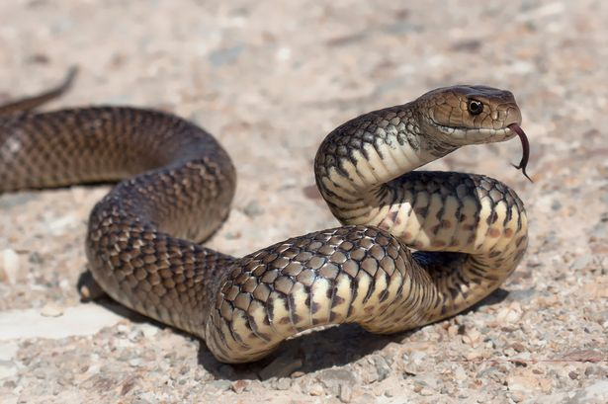
Snake

Slide 39
Poultry

Slide 40
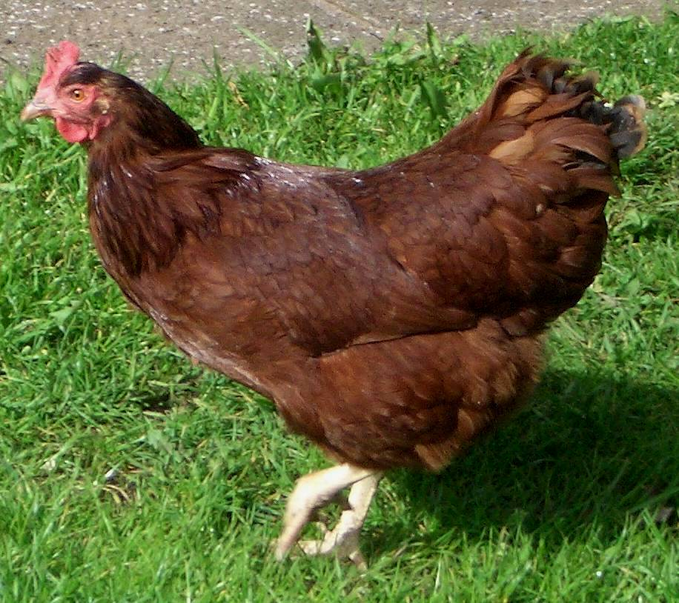
Rhode Island Red

Slide 41
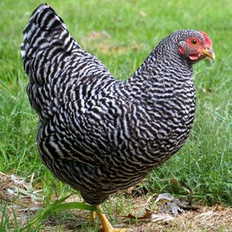
Plymouth Rock

Slide 42
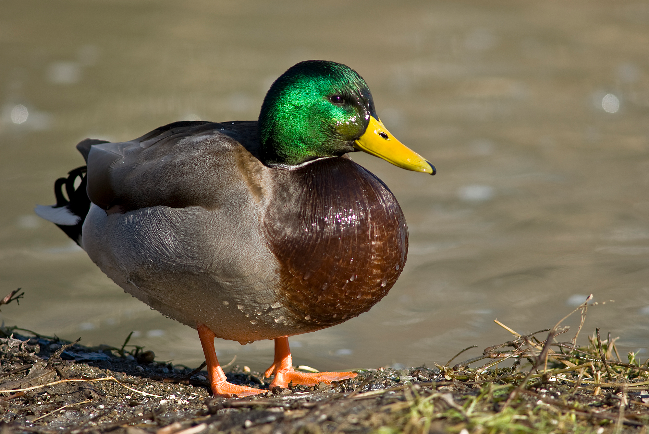
Duck

Slide 43
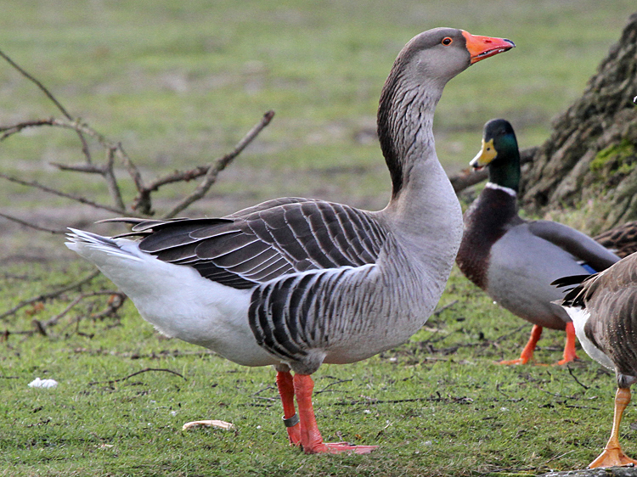
Geese

Slide 44
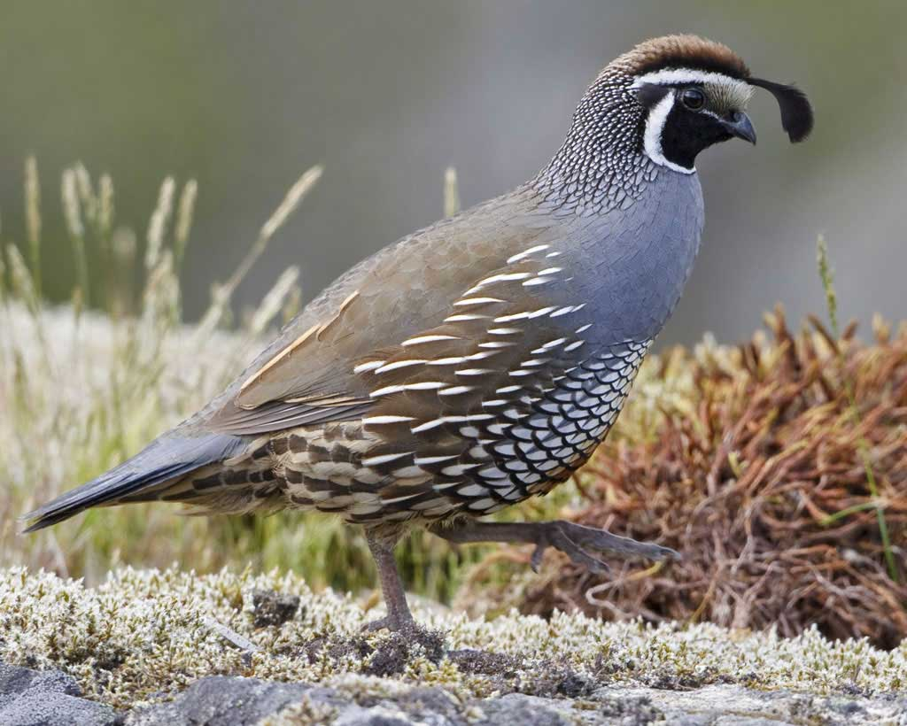
Quail

Slide 45
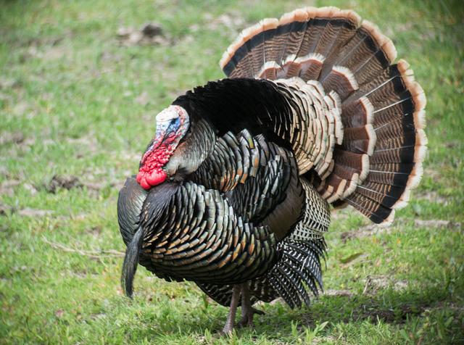
Turkey

Slide 46
Dairy Cattle

Slide 47
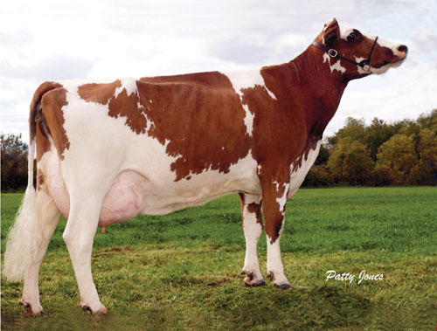
Ayrshire

Slide 48
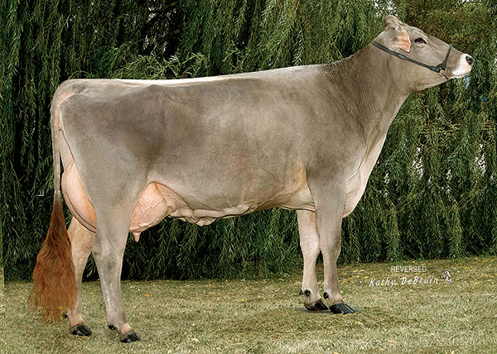
Brown Swiss

Slide 49
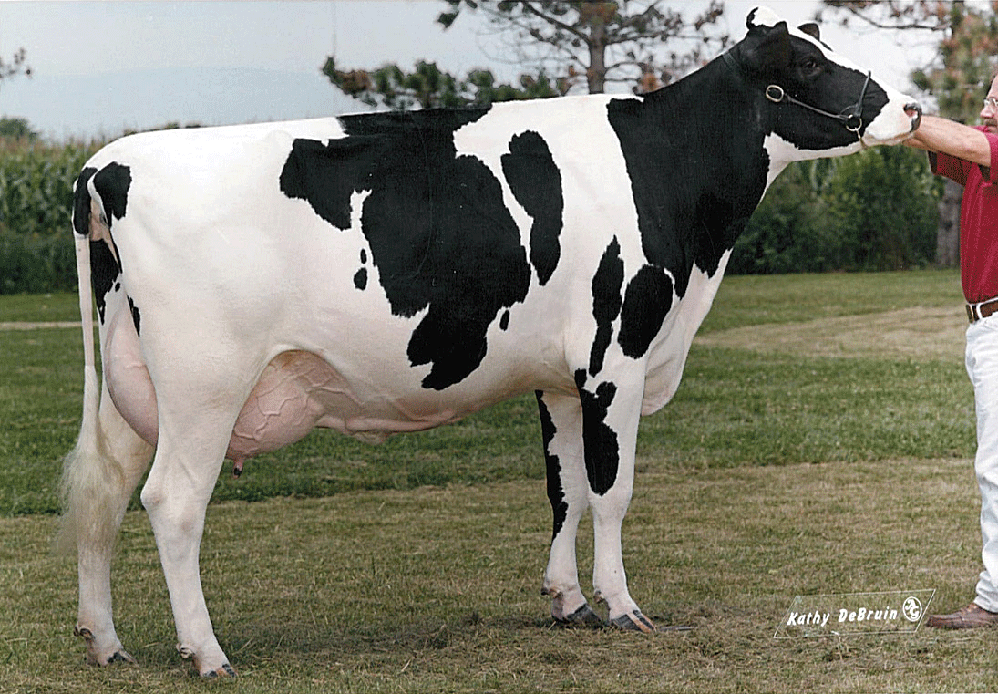
Holstein

Slide 50
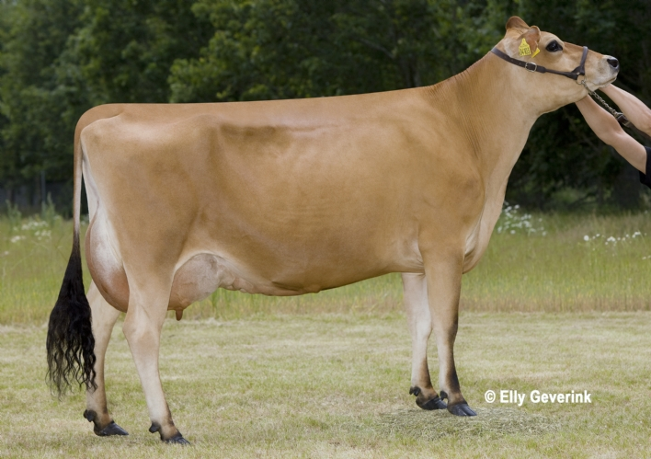
Jersey

Slide 51
Beef Cattle

Slide 52
Angus

Slide 53
Brahman

Slide 54
Charolais

Slide 55
Hereford

Slide 56
Shorthorn

Slide 57
Swine

Slide 58
American Landrace

Slide 59
Berkshire

Slide 60
Duroc

Slide 61
Hampshire

Slide 62
Yorkshire

Slide 63
Horse

Slide 64
Appaloosa

Slide 65
Arabian

Slide 66
Clydesdale

Slide 67
Morgan

Slide 68
Paint/Pinto

Slide 69
Quarter Horse

Slide 70
Saddlebred

Slide 71
Tennessee Walking Horse

Slide 72
Thoroughbred

Slide 73
Donkey

Slide 74
Goat

Slide 75
Alpine

Slide 76
Nubian

Slide 77
Angora

Slide 78
Boer

Slide 79
LaMancha

Slide 80
Saanen

Slide 81
Sheep

Slide 82
Cheviot

Slide 83
Columbia

Slide 84
Dorset

Slide 85
Hampshire

Slide 86
Jacob

Slide 87
Southdown

Slide 88
Suffolk

