Slide 1
Sporting Group

Slide 2
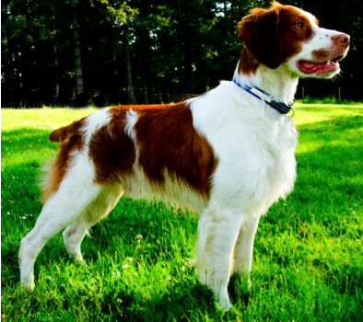
Brittany

Slide 3
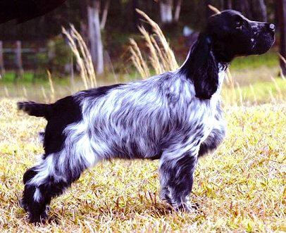
Cocker Spaniel

Slide 4
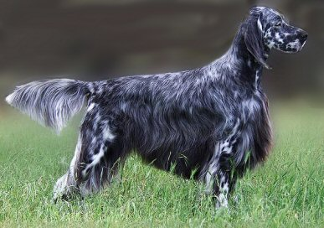
English Setter

Slide 5
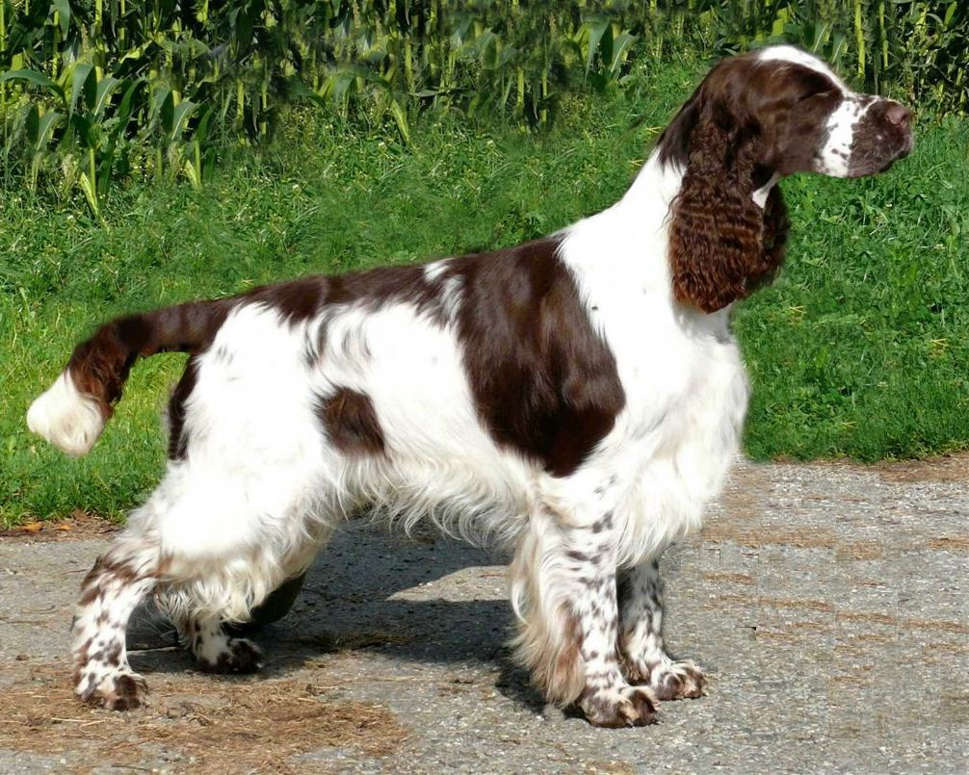
English Springer Spaniel

Slide 6
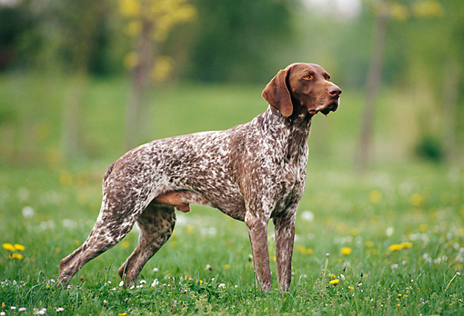
German Shorthaired Pointer

Slide 7
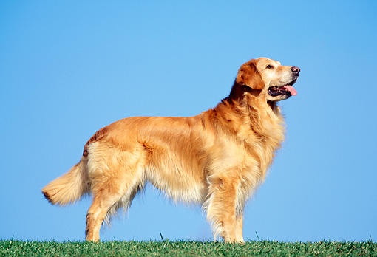
Golden Retriever

Slide 8
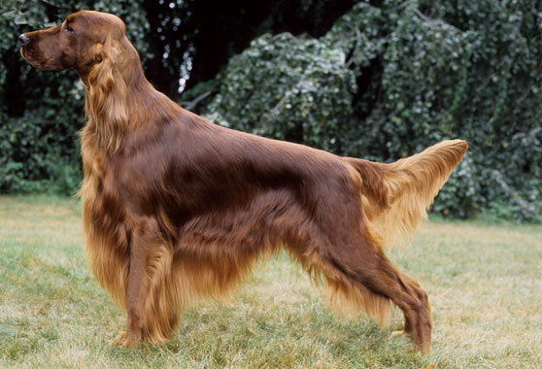
Irish Setter

Slide 9
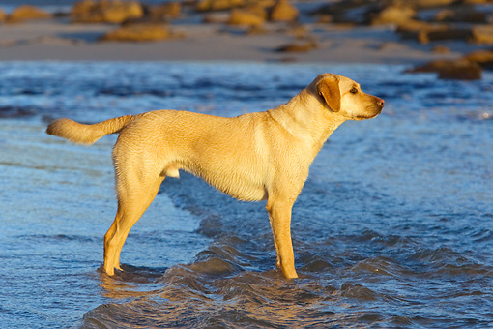
Labrador Retriever

Slide 10
Non-Sporting Group

Slide 11
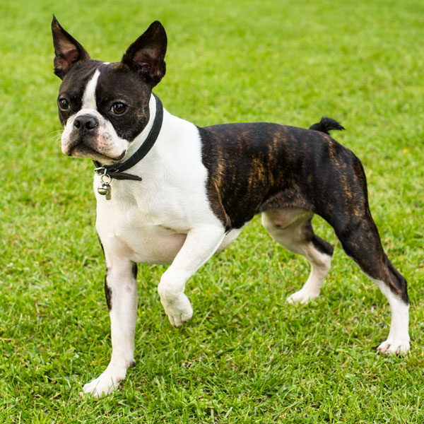
Boston Terrier

Slide 12
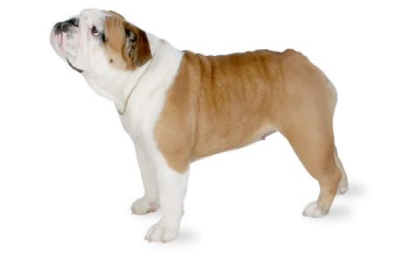
Bulldog

Slide 13
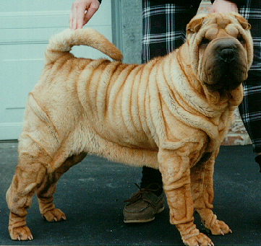
Chinese Shar-Pei

Slide 14
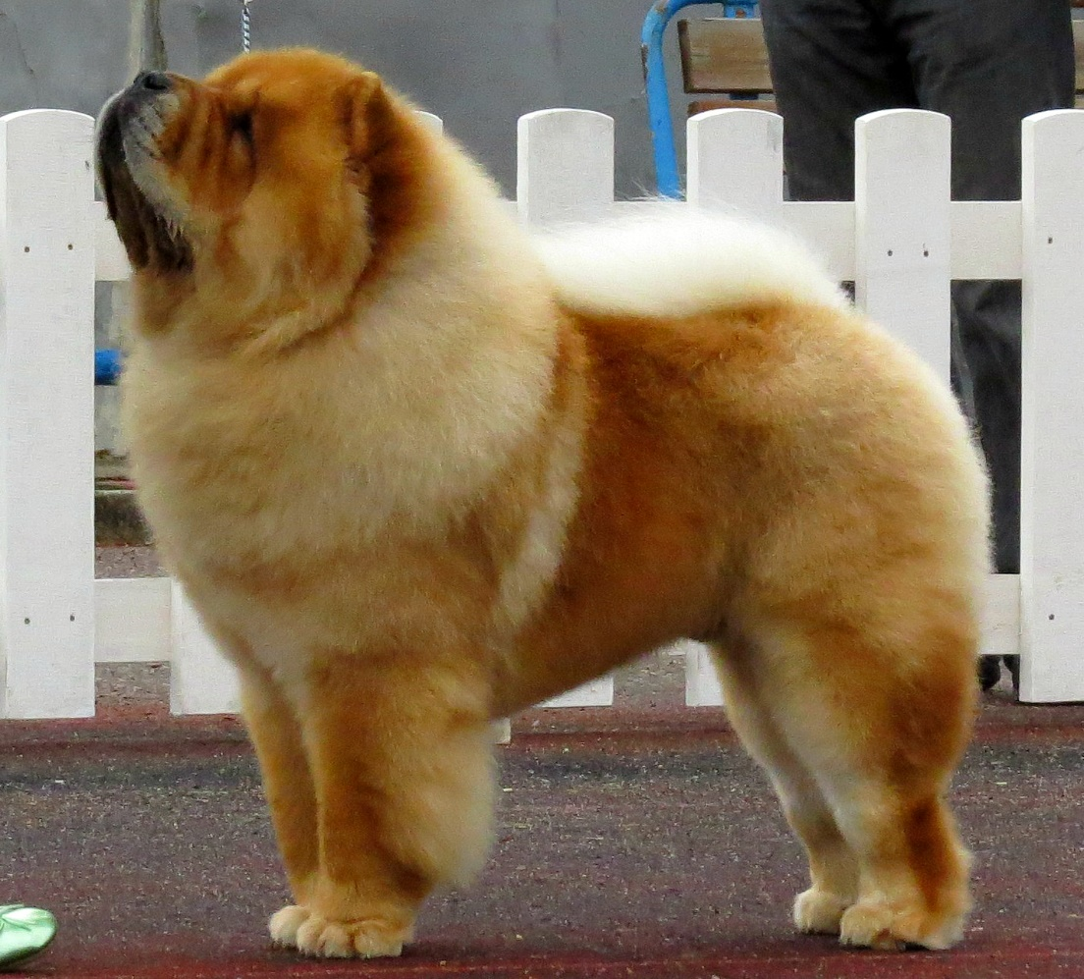
Chow Chow

Slide 15
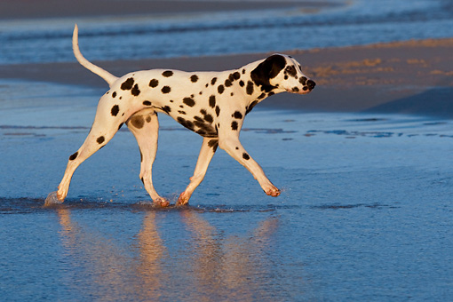
Dalmatian

Slide 16
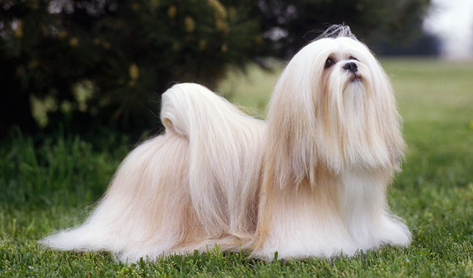
Lhasa Apso

Slide 17
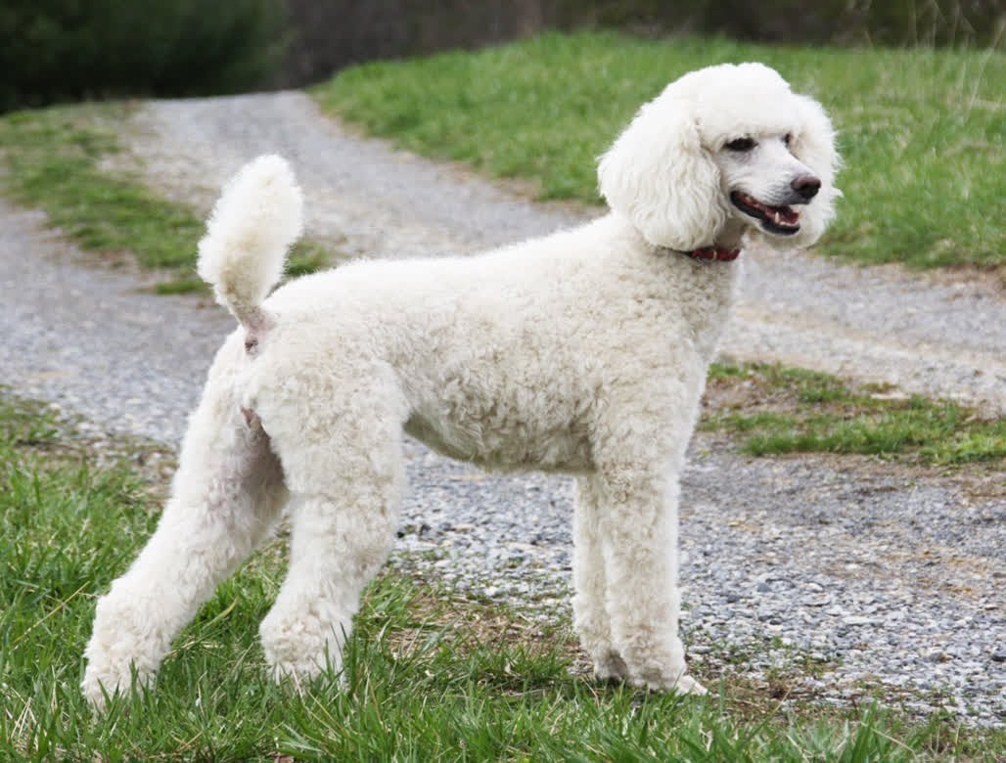
Poodle

Slide 18
Terrier Group

Slide 19
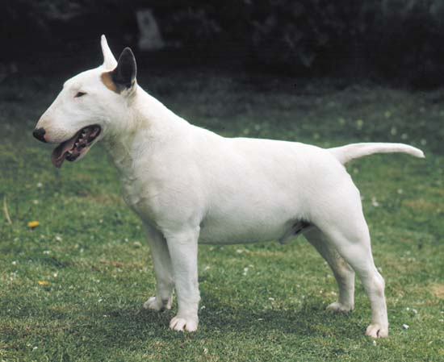
Bull Terrier

Slide 20
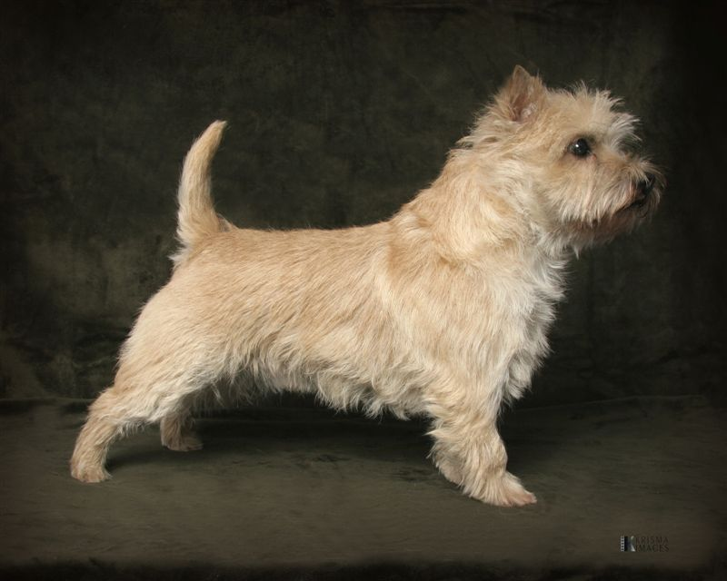
Cairn Terrier

Slide 21
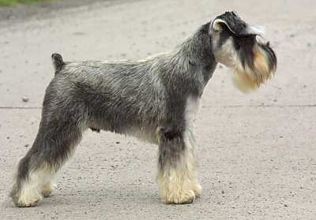
Miniature Schnauzer

Slide 22
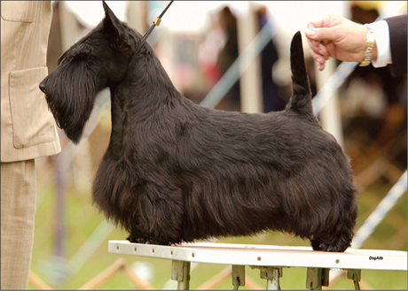
Scottish Terrier

Slide 23
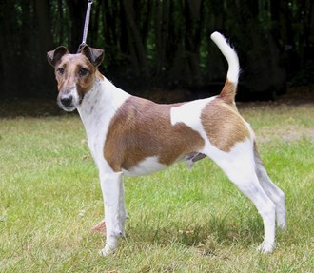
Smooth Fox Terrier

Slide 24
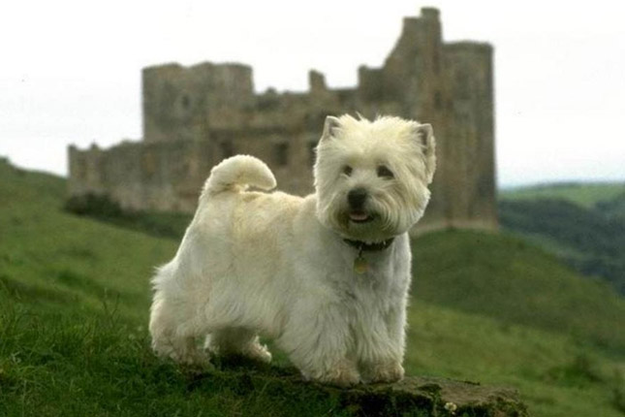
West Highland White Terrier

Slide 25
Herding Group

Slide 26
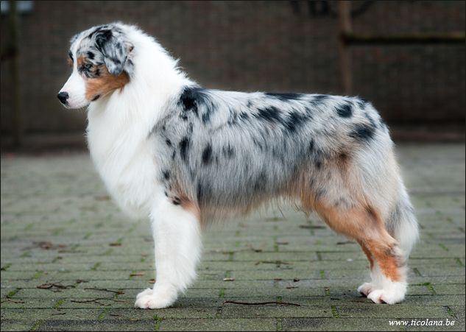
Australian Shepherd

Slide 27
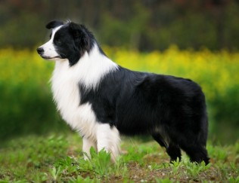
Border Collie

Slide 28
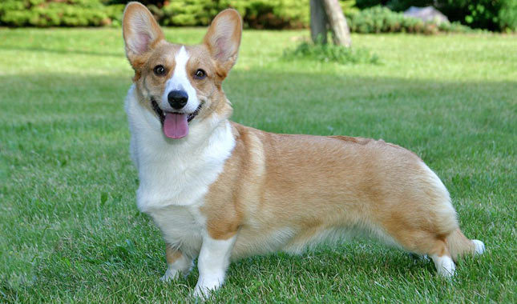
Cardigan Welsh Corgi

Slide 29
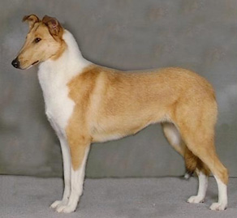
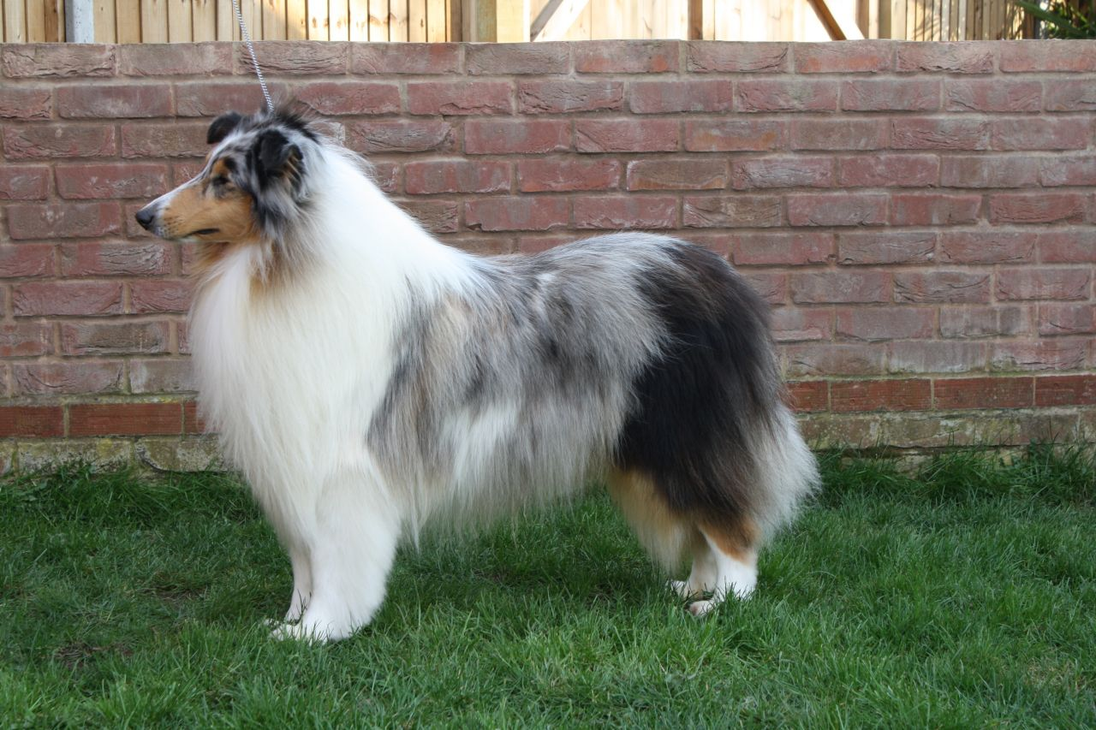
Collie
Smooth Collie
Rough Collie

Slide 30
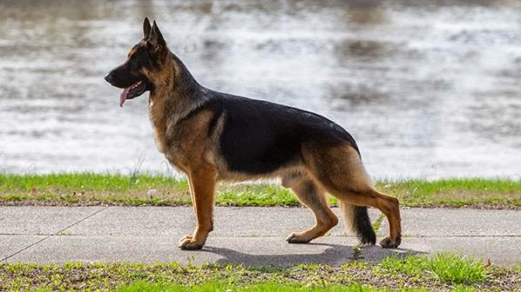
German Shepherd

Slide 31
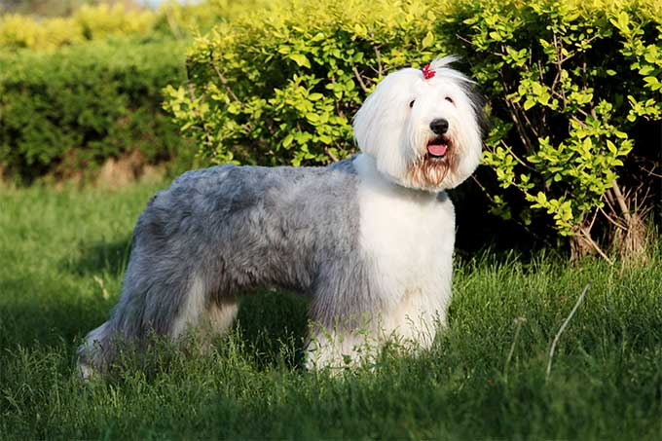
Old English Sheepdog

Slide 32
The Working Group

Slide 33
Akita

Slide 34
Bernese Mountain Dog

Slide 35
Boxer

Slide 36
Doberman Pinscher

Slide 37
Giant Schnauzer

Slide 38
Great Dane

Slide 39
Great Pyrenees

Slide 40
Mastiff

Slide 41
Newfoundland

Slide 42
Portuguese Water Dog

Slide 43
Rottweiler

Slide 44
Saint Bernard

Slide 45
Samoyed

Slide 46
Siberian Husky

Slide 47
Toy Group

Slide 48
Cavalier King Charles Spaniel

Slide 49
Chihuahua

Slide 50
Maltese

Slide 51
Miniature Pinscher

Slide 52
Pekingese

Slide 53
Pomeranian

Slide 54
Pug

Slide 55
Yorkshire Terrier

Slide 56
Hound Group

Slide 57
Afghan Hound

Slide 58
American Foxhound

Slide 59
Basenji

Slide 60
Basset Hound

Slide 61
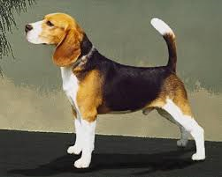
Beagle

Slide 62
Black and Tan Coonhound

Slide 63
Bloodhound

Slide 64
Greyhound

